Slide 1

Cycle 3
Visualization
Project #3 Team Orange
Cady Pridgeon, Amee Kivette, Keanna Tennyson, Laura Wilson

Slide 2
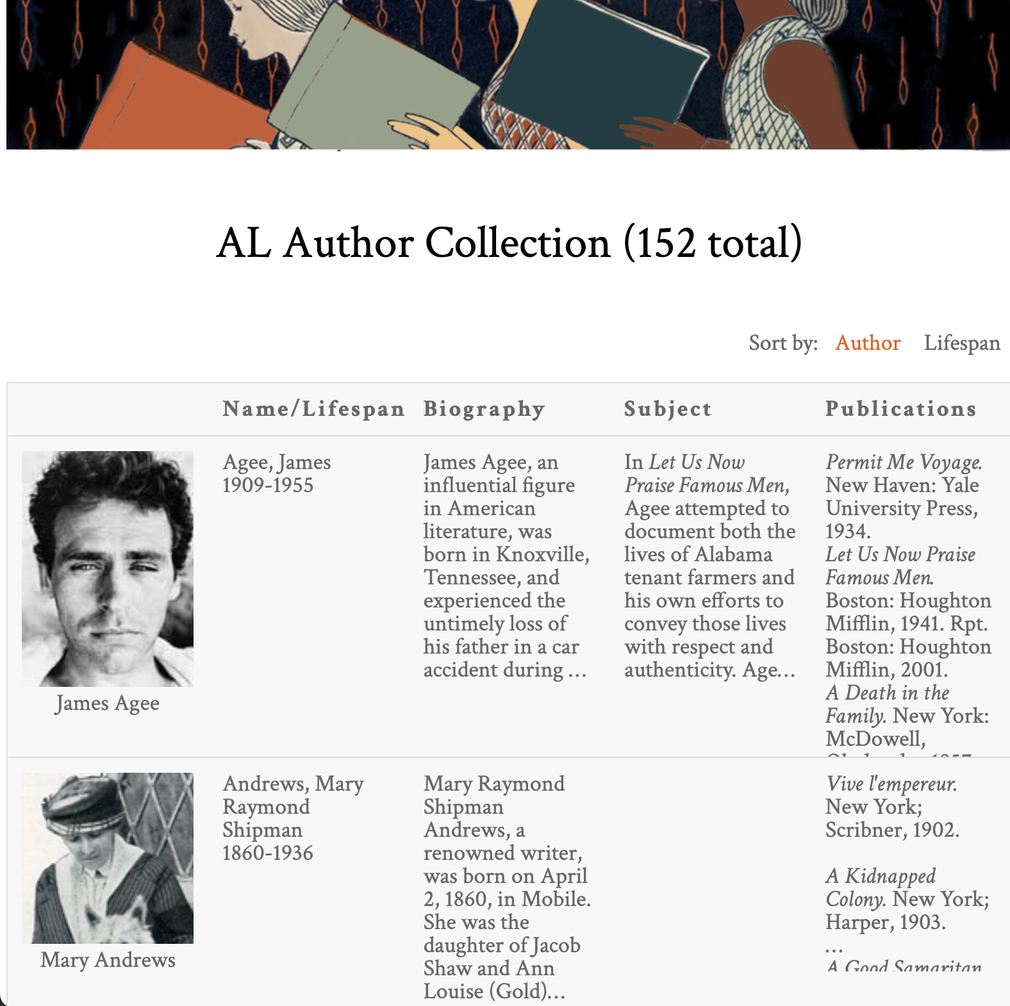
Alabama Authors
Laura Wilson
Introduction
Alabama Authors of the 19th and 20th Centuries
Dr. Beverly Park Rilett
Project Mission
Visualize wealth of data
Author lifespans
Chronology
Encourages data exploration
Valuable for research
Sample of the AL Author Collection from the Alabama Authors website

Slide 3

System Metaphor & Cycle Intent
Laura Wilson
System Metaphor
Museum exhibit
Allows visitors to take a glance before diving in
Cycle Intent
Neatline Visualization
Add data points onto timeline
Ensure consistent formatting
D3.js Sunburst
Implement sunburst visualization
Add support features
Person viewing art at an art gallery or exhibit

Slide 4
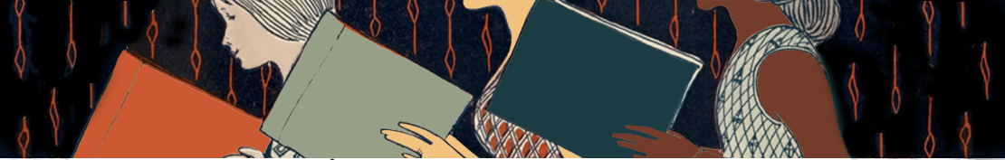
User Stories

Slide 5
1.0 Chronology Data Visualization
Cady Pridgeon
Summary
As a user, I want to view authors on the Alabama Authors website in a chronology/timeline format to better explore and learn about the authors.
Description
This type of visualization enables users to explore the periods authors were alive and popular in order to facilitate education, understanding, and research of the authors.
Status
Completed

Slide 6
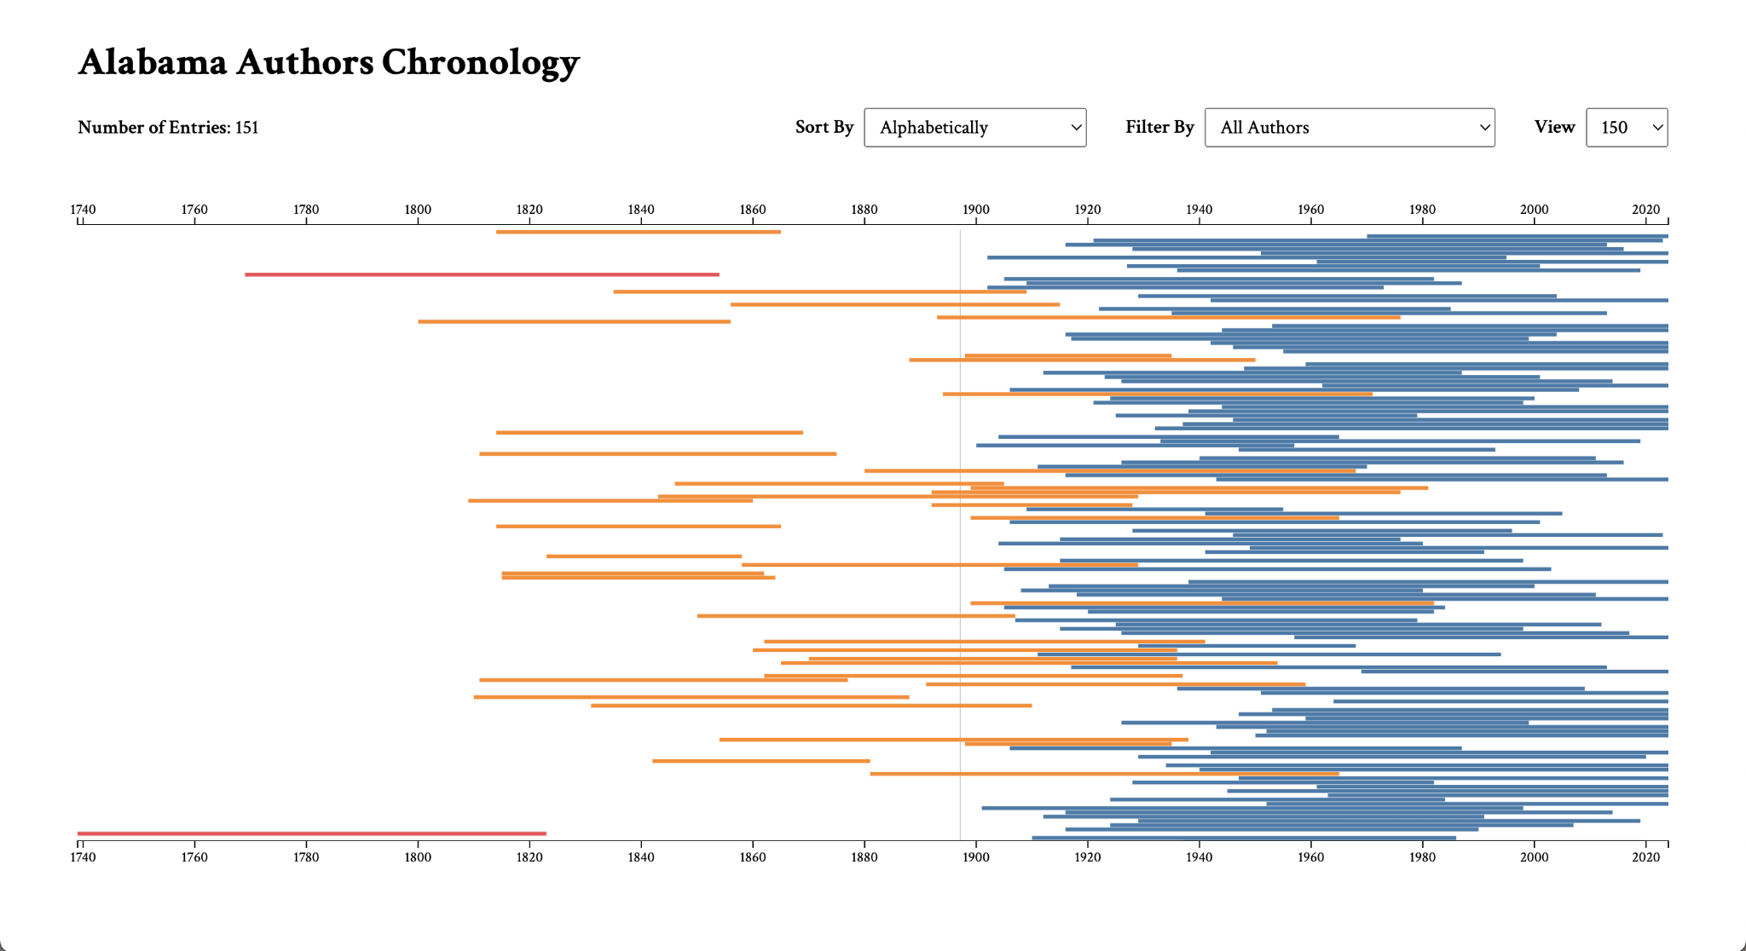
User Story 1.0 Progress
D3.js chronology

Slide 7
1.1 Chronology Data Visualization
Cady Pridgeon
Summary
As a user, I want to be able to see author names, birth years, death years, and image when I hover over or select nodes in order to quickly learn about the author without having to navigate to their details page.
Description
Allowing users to see important information at a glance on the visualization supports their exploration and search of authors. It also helps to differentiate nodes within the visualization.
Status
Completed

Slide 8
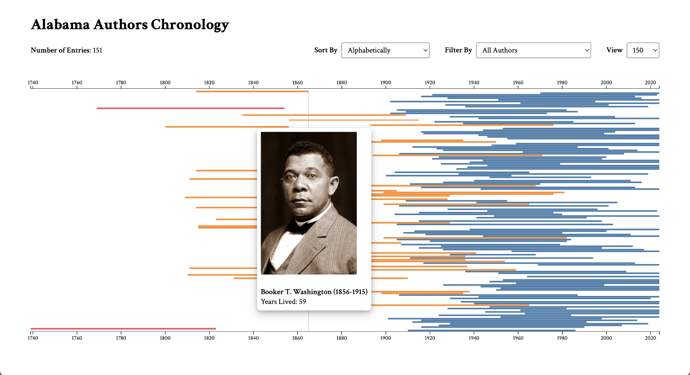
User Story 1.1 Progress
D3.js chronology

Slide 9
1.2 Chronology Data Visualization
Cady Pridgeon
Summary
As a user, I want to be able to interact with author nodes on the visualization to access their details page, allowing me to quickly learn more about authors directly from the chronology.
Description
There are detailed pages for each author in the database, so it would support research and education about authors by permitting users to access these informative pages straight from a visualization.
Status
Completed

Slide 10
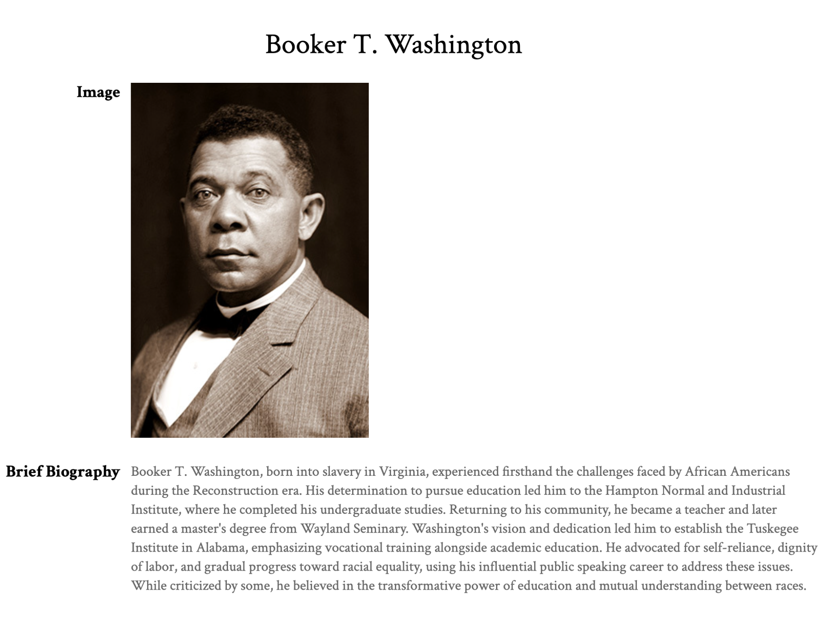
User Story 1.2 Progress
D3.js chronology
Author details page on Alabama Authors website

Slide 11
1.3 Chronology Data Visualization
Cady Pridgeon
Summary
As a user, I want to be able to filter the visualization based on criteria, such as birth year or author name, in order to customize my exploration of relevant information.
Description
Including filtering functionality better equips users for efficient data exploration. Without it, users may feel frustrated or experience cognitive overload if they are unable to access information of interest quickly and effectively.
Status
Completed

Slide 12
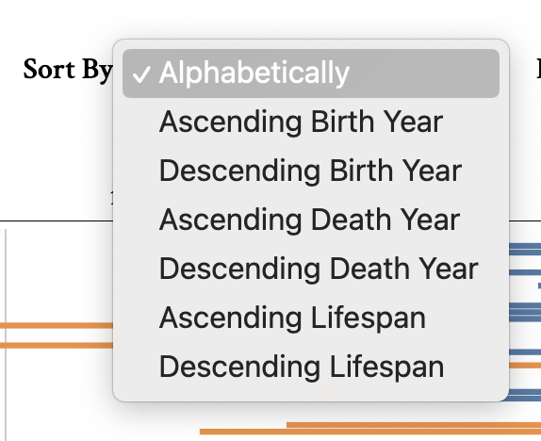
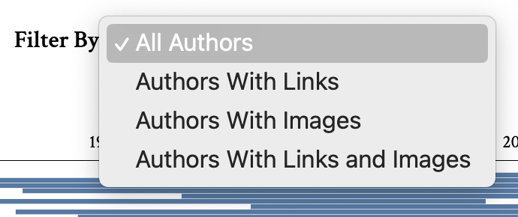
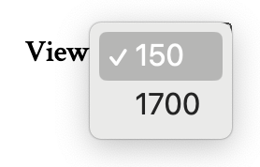
User Story 1.3 Progress
D3.js chronology view options
D3.js chronology filter options
D3.js chronology sort options

Slide 13
1.4 Chronology Data Visualization
Cady Pridgeon
Summary
As a user, I want to view all of the Alabama authors from the 19th and 20th century to gain a complete picture of the literary landscape from this area and time.
Description
Currently, the website includes 150 authors in its literary map visualization and detail pages. However, there are around 1,500 data entries for authors from this time, so it is important to include these additional data points for completeness.
Status
Completed

Slide 14
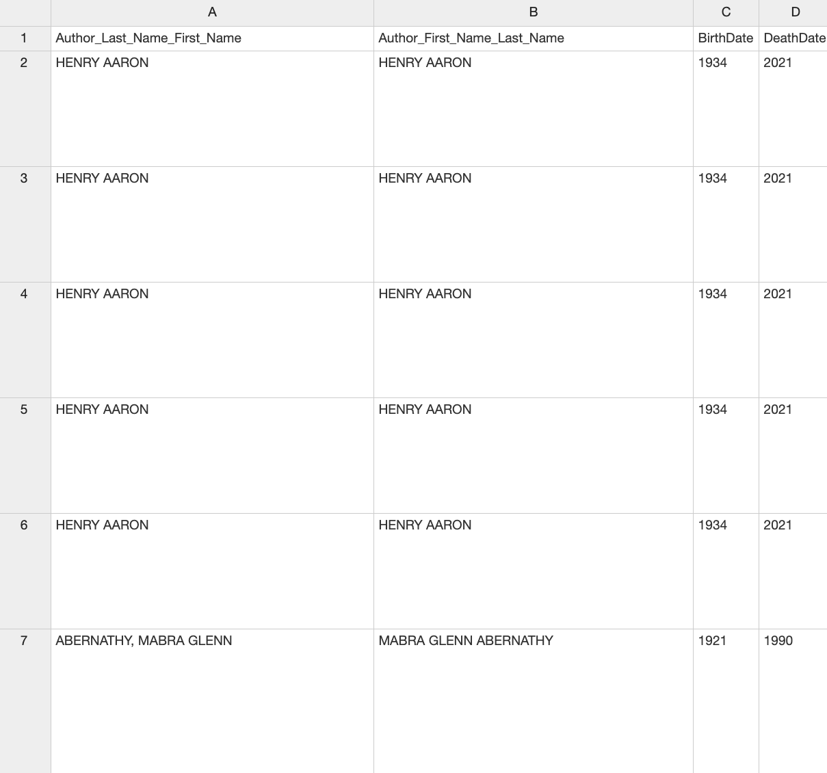
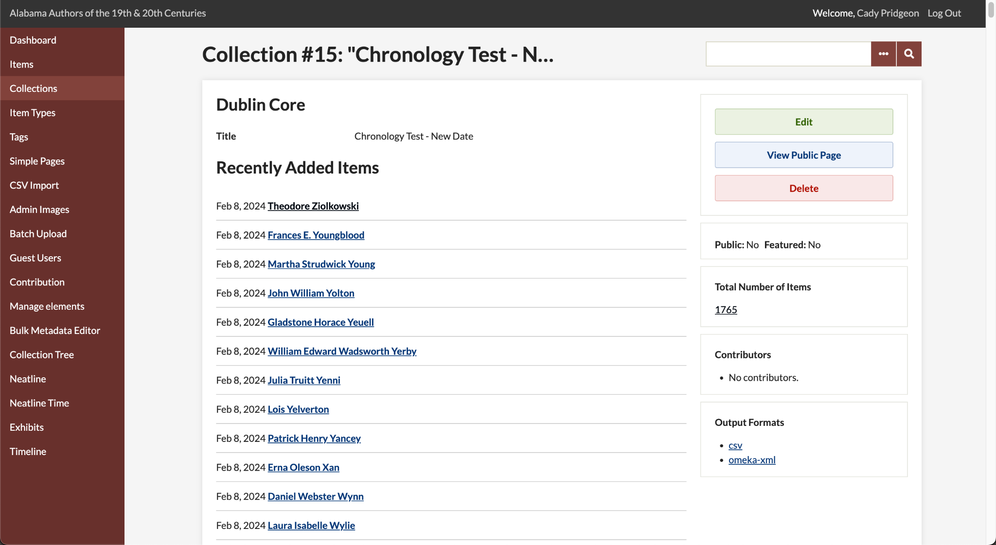
User Story 1.4 Progress
Alabama Authors data entries
Alabama Authors data in Omeka Classic

Slide 15
1.5 Chronology Data Visualization
Cady Pridgeon
Summary
As a user, I want to be able to access the Alabama Authors website from any device, such as a computer, tablet, or phone, and experience an accessible data visualization.
Description
The data visualization should be responsive, supporting users from any device, including a mobile phone.
Status
Completed

Slide 16
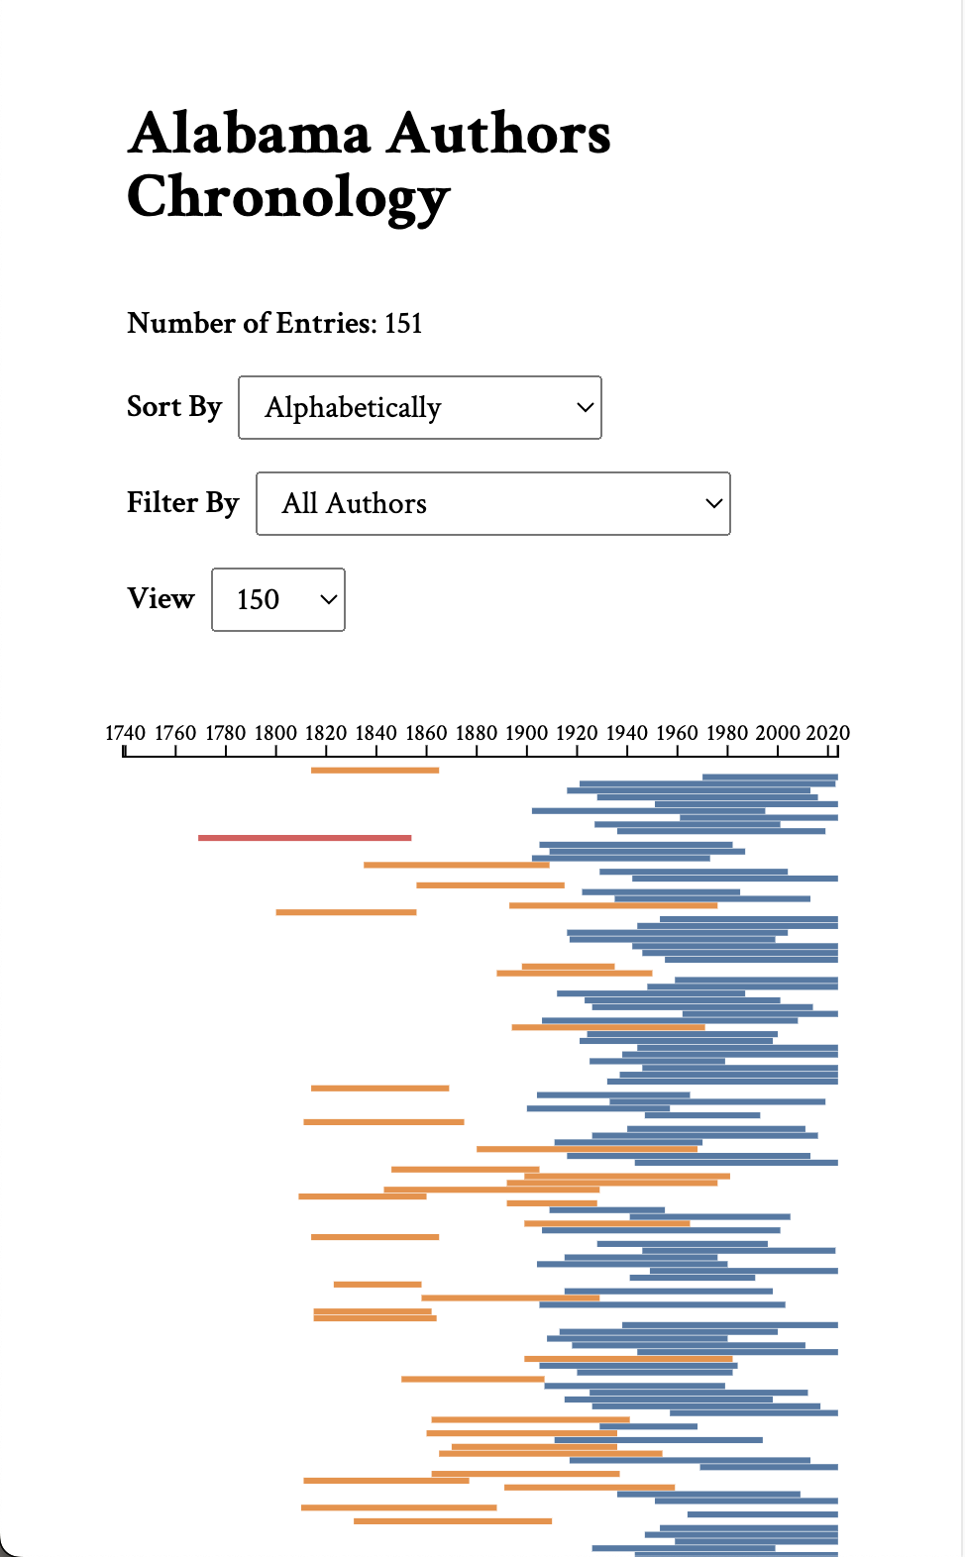
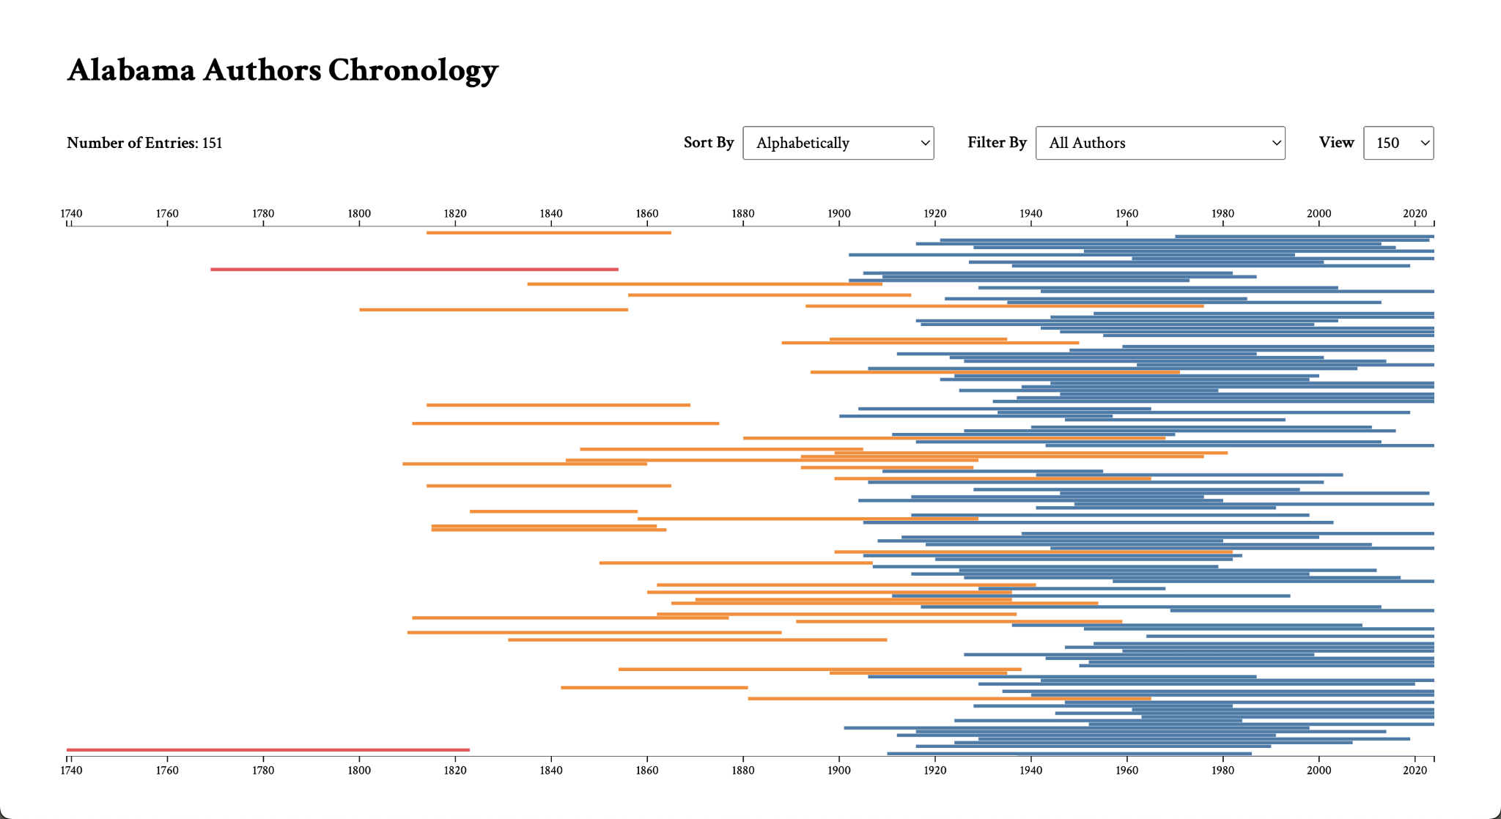
User Story 1.5 Progress
D3.js chronology on mobile
D3.js chronology on desktop

Slide 17
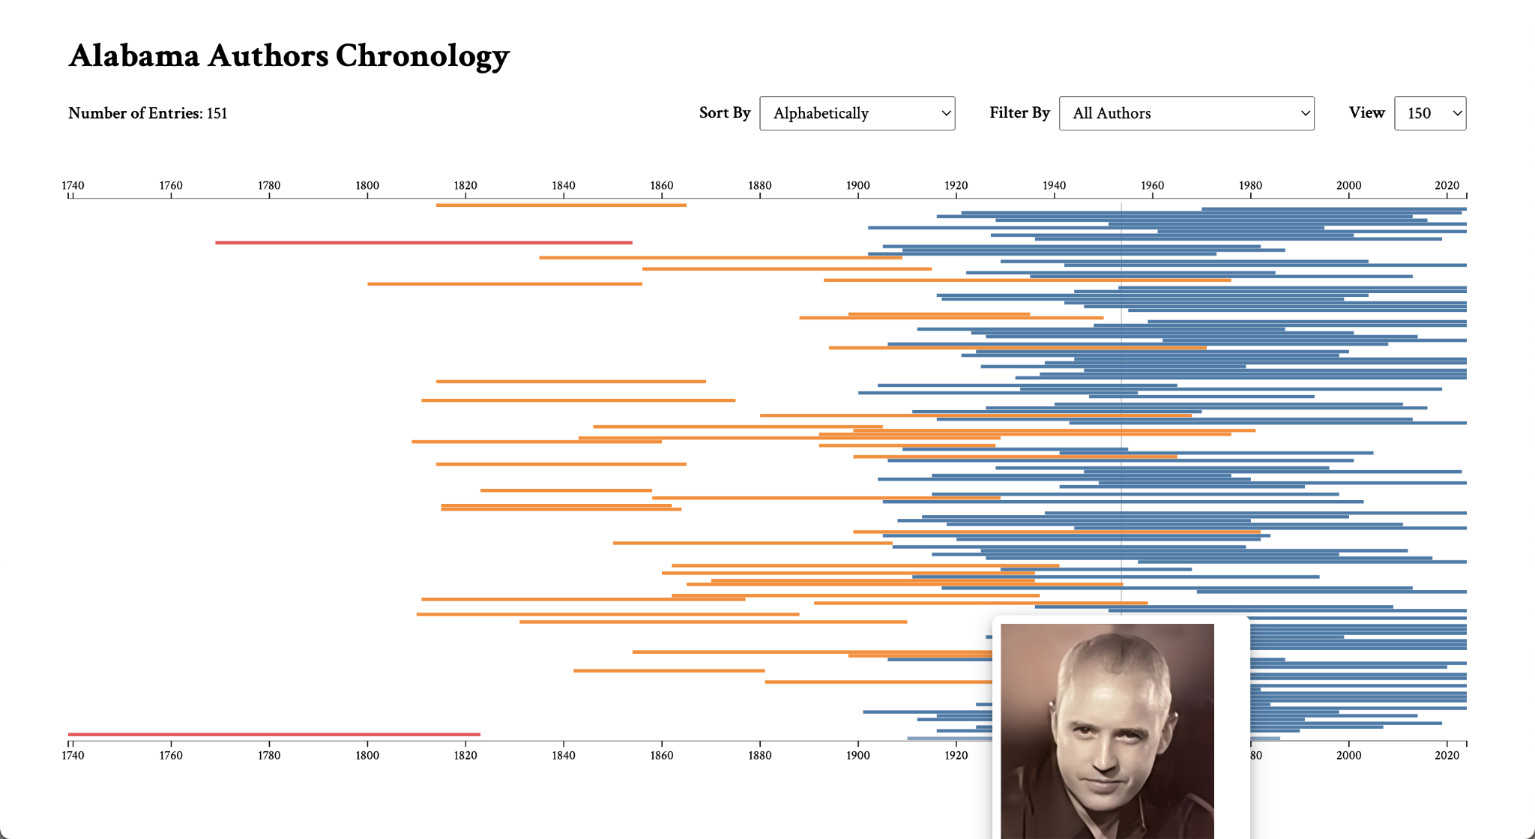
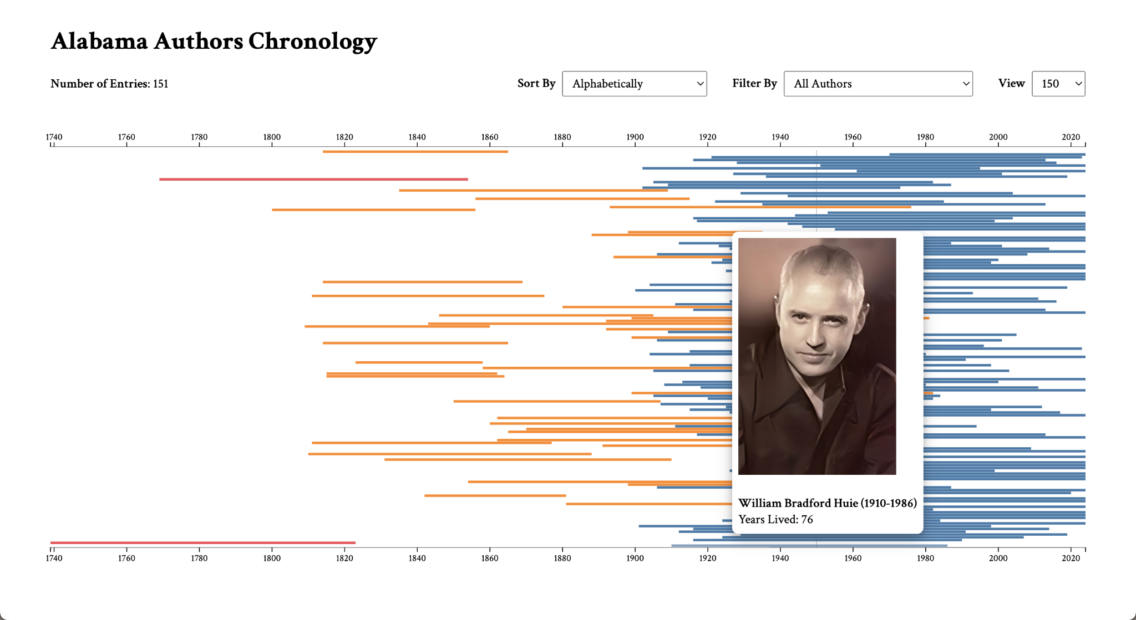
User Story 1.5 Progress
Previous D3.js chronology hover
Current D3.js chronology hover

Slide 18
1.6 Chronology Data Visualization
Cady Pridgeon
Summary
As a user, I want to experience an accessible user interface on the Alabama Authors website to ensure my abilities do not interfere with viable interactions on the website.
Description
Color contrast, tab index, and verbiage are a few aspects that make an interface accessible and inclusive. It is crucial that anyone, regardless of their abilities, should be able to access and navigate the website and visualizations with ease.
Status
Completed

Slide 19
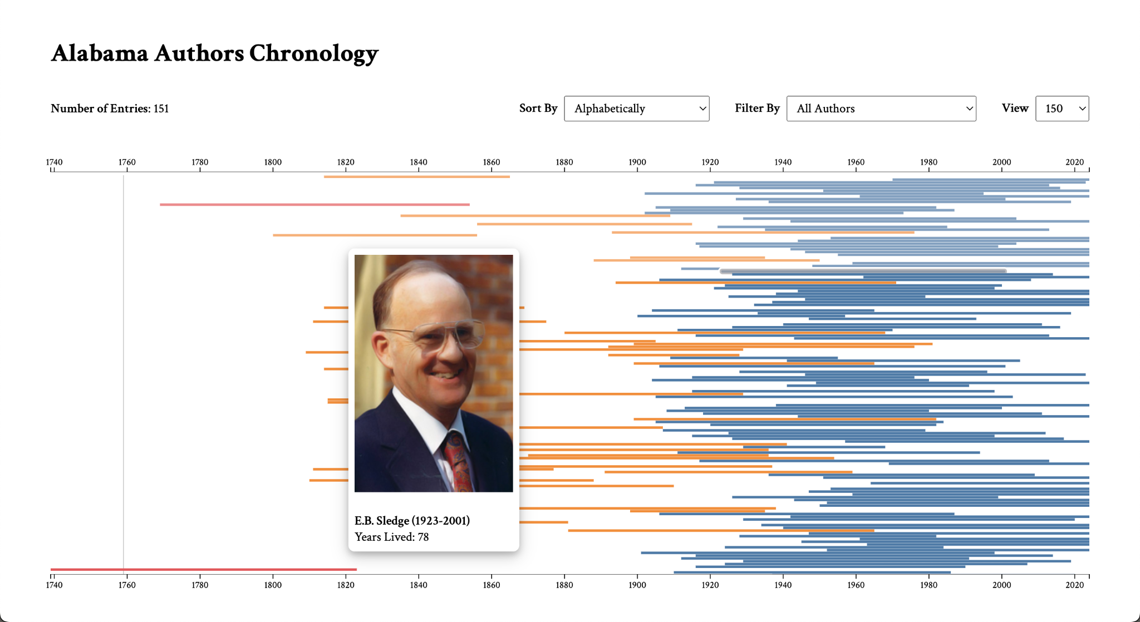
User Story 1.6 Progress
Using tab index to navigate the D3.js chronology visualization

Slide 20
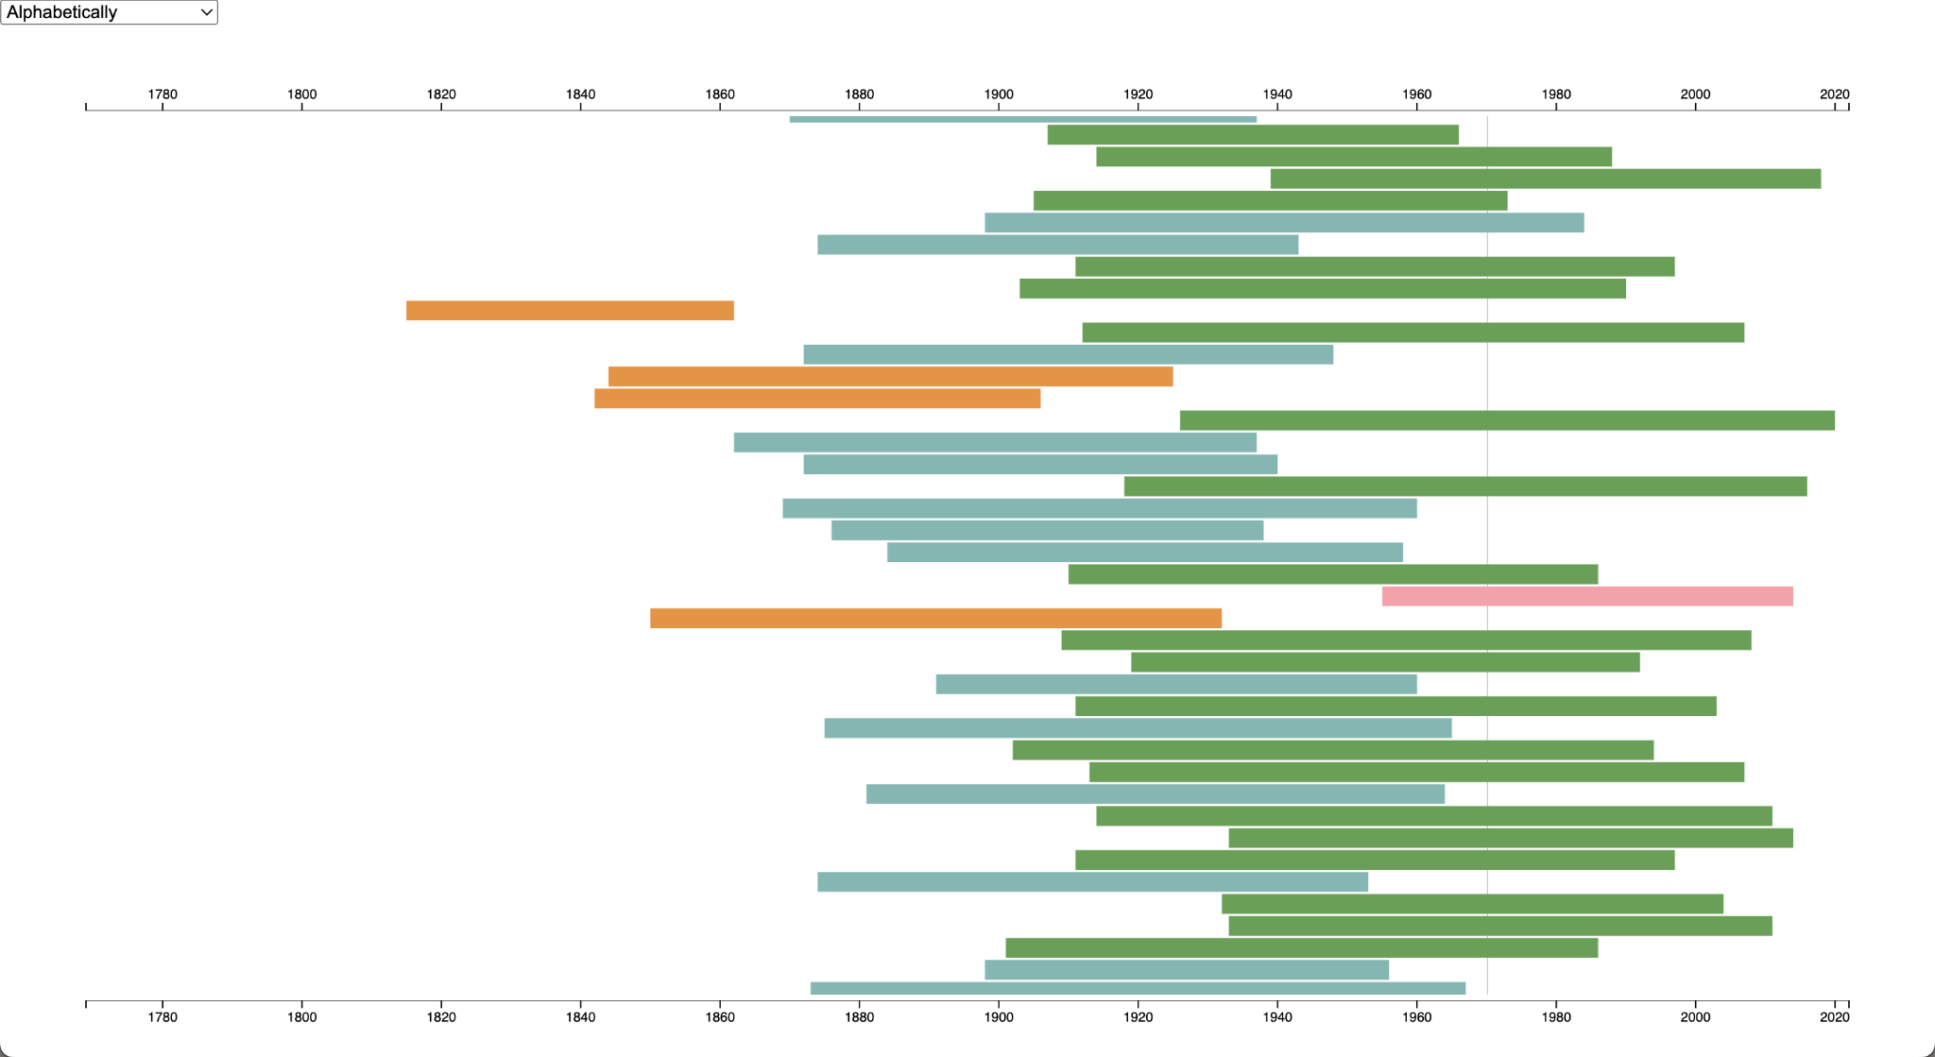
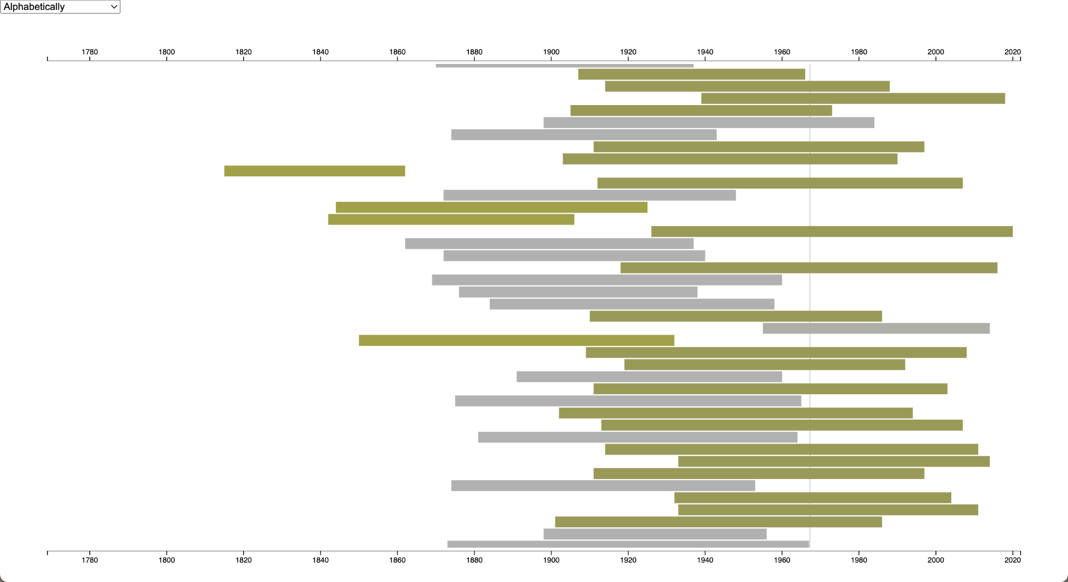
User Story 1.6 Progress
Viewing initial D3.js chronology with trichromacy / normal vision
Viewing initial D3.js chronology with red-blindness / protanopia

Slide 21
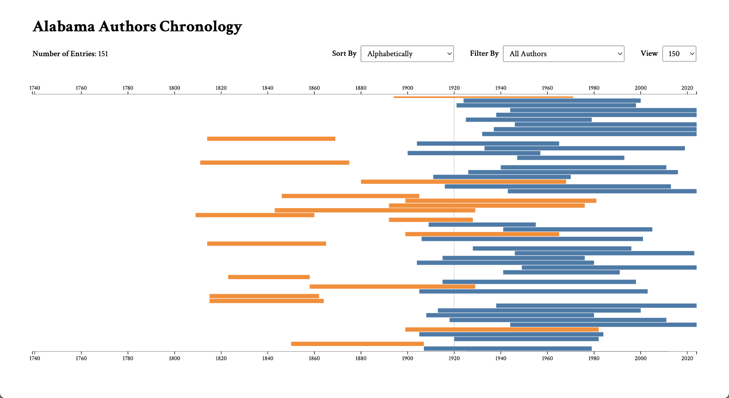
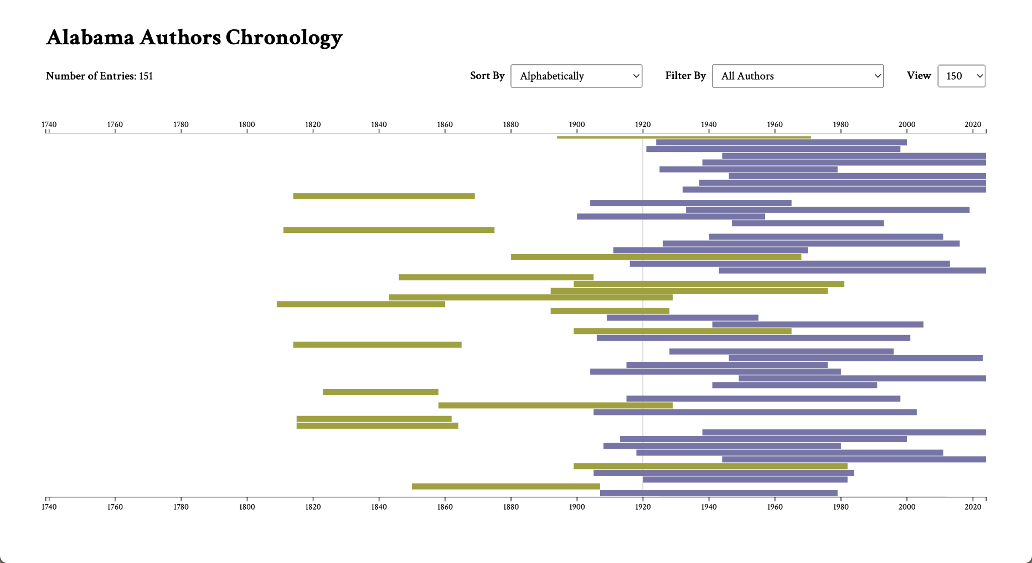
User Story 1.6 Progress
Viewing current D3.js chronology with trichromacy / normal vision
Viewing current D3.js chronology with red-blindness / protanopia

Slide 22
1.7 Chronology Data Visualization
Cady Pridgeon
Summary
As a user, I want to view only the 150 completed Alabama Authors found on the website on the chronology to bring improved alignment and consistency to my research and exploration experience.
Description
Previously, the D3.js chronology visualization utilized the 1700 author data entries, even though these authors were not published on the website. To keep the visualization and website more consistent, the chronology would use the author collection data.
Status
Completed

Slide 23
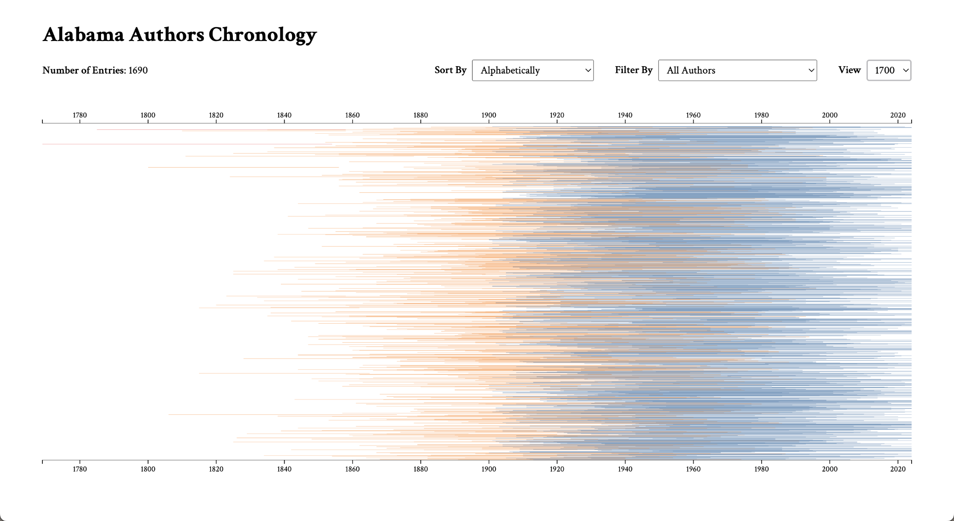
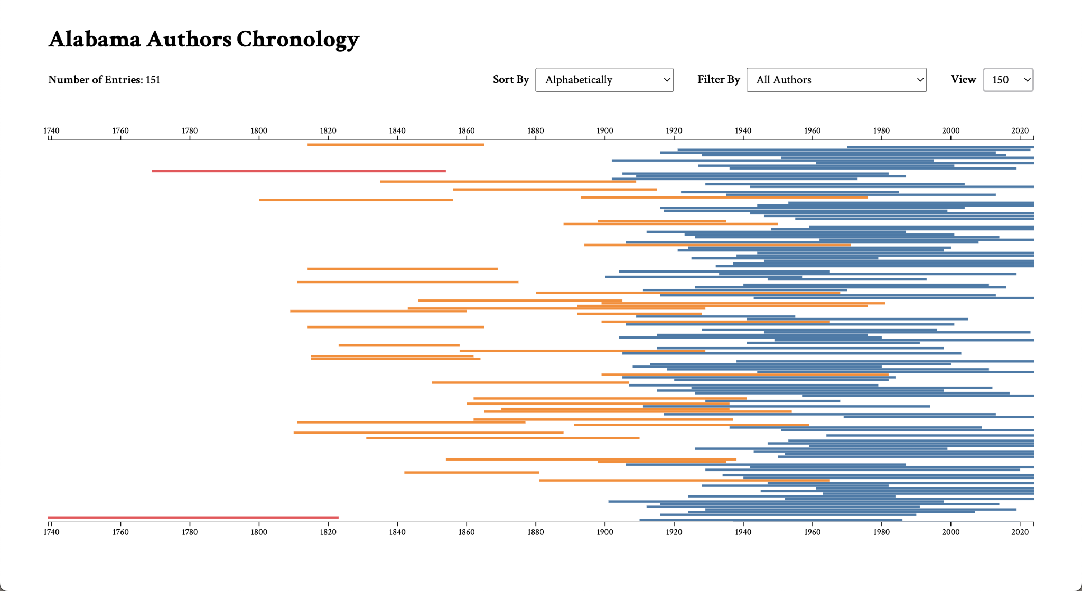
User Story 1.7 Progress
Viewing D3.js chronology with 1700 author entries
Viewing D3.js chronology with 150 author entries

Slide 24
2.0 Author Details Page
Cady Pridgeon
Summary
As a user, I want to view an author's date of birth and date of death on their details page to quickly remember the period they lived through.
Description
While users can view an author's date of birth on data visualizations, their birth date and death date are missing from their detail page. This could frustrate users by creating an inconsistency in data availability over various pages on the site.
Status
Discarded

Slide 25
3.0 Calendar Wheel Visualization
Amee Kivette
Summary
As a user, I want to view publications from the Alabama Authors Book List Collection on an interactive calendar wheel.
Description
An interactive calendar wheel visualization would enable users to access specific time periods to identify and analyze the associated publications. This would facilitate the education, understanding, and research of the publications.
Status
Completed

Slide 26
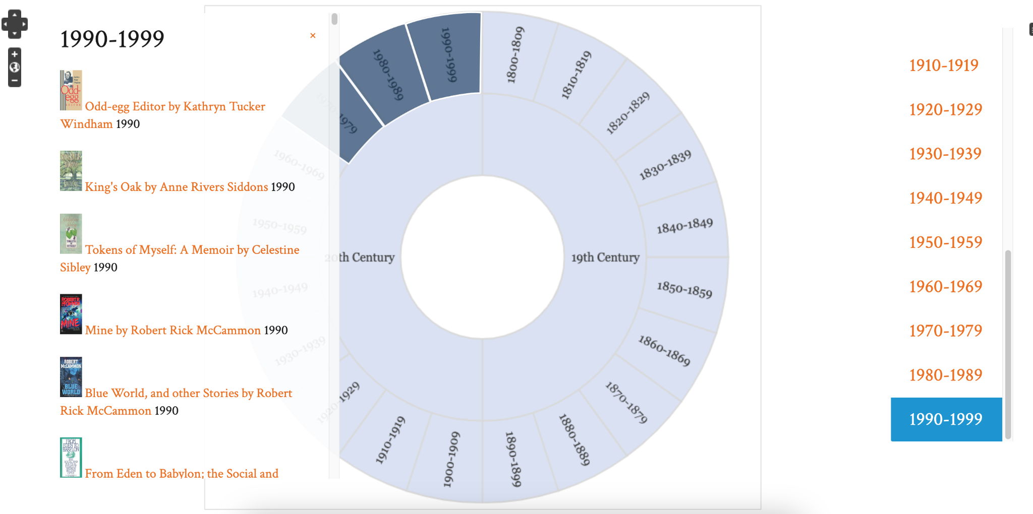
User Story 3.0 Progress
Neatline publication data visualization

Slide 27
3.1 Calendar Wheel Visualization
Amee Kivette
Summary
As a user, I want to view the publication densities of each time period on the calendar wheel as a heat map.
Description
A heat map of the publication densities would provide a comprehensive view of the magnitude of the collection throughout the decades of the 19th and 20th centuries.
Status
Completed

Slide 28
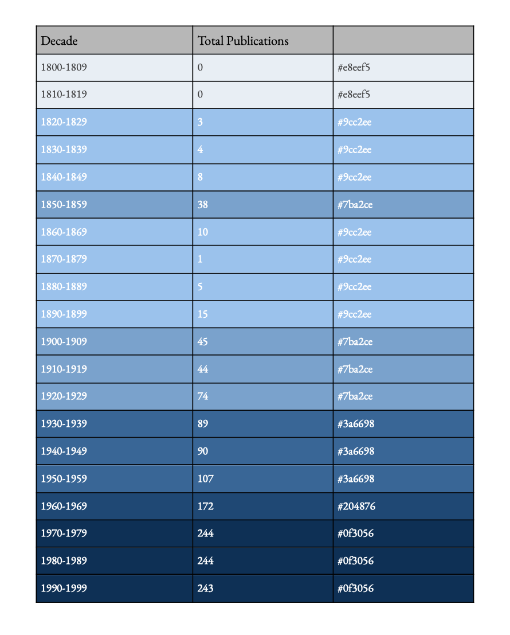
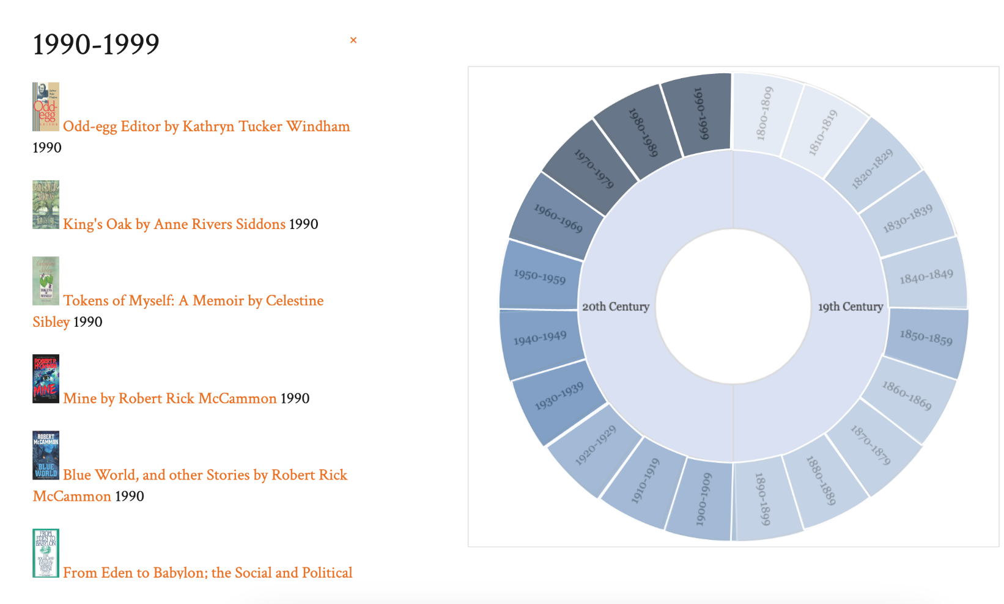
User Story 3.1 Progress
Neatline publication data visualization
Neatline publication densities by decade

Slide 29
3.2 Calendar Wheel Visualization
Amee Kivette
Summary
As a user, I want to be able to interact with publication items on the visualization to access their details page, allowing me to quickly learn more about publications directly from the chronology.
Description
There are detailed pages for each publication in the database, so it would support research and education about publications by permitting users to access these informative pages straight from a visualization.
Status
Completed

Slide 30
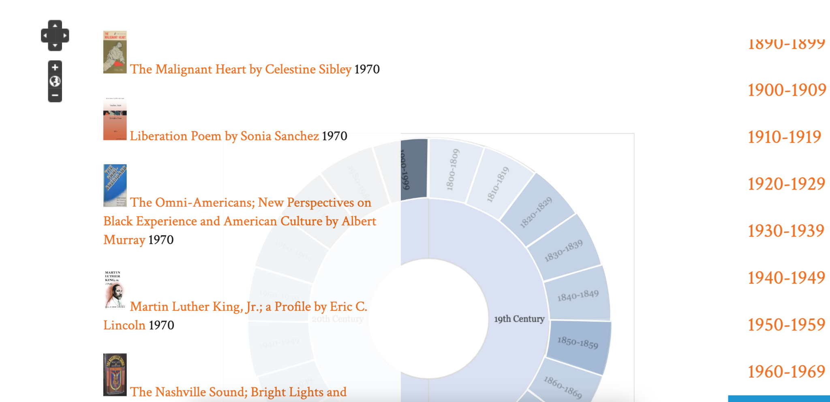
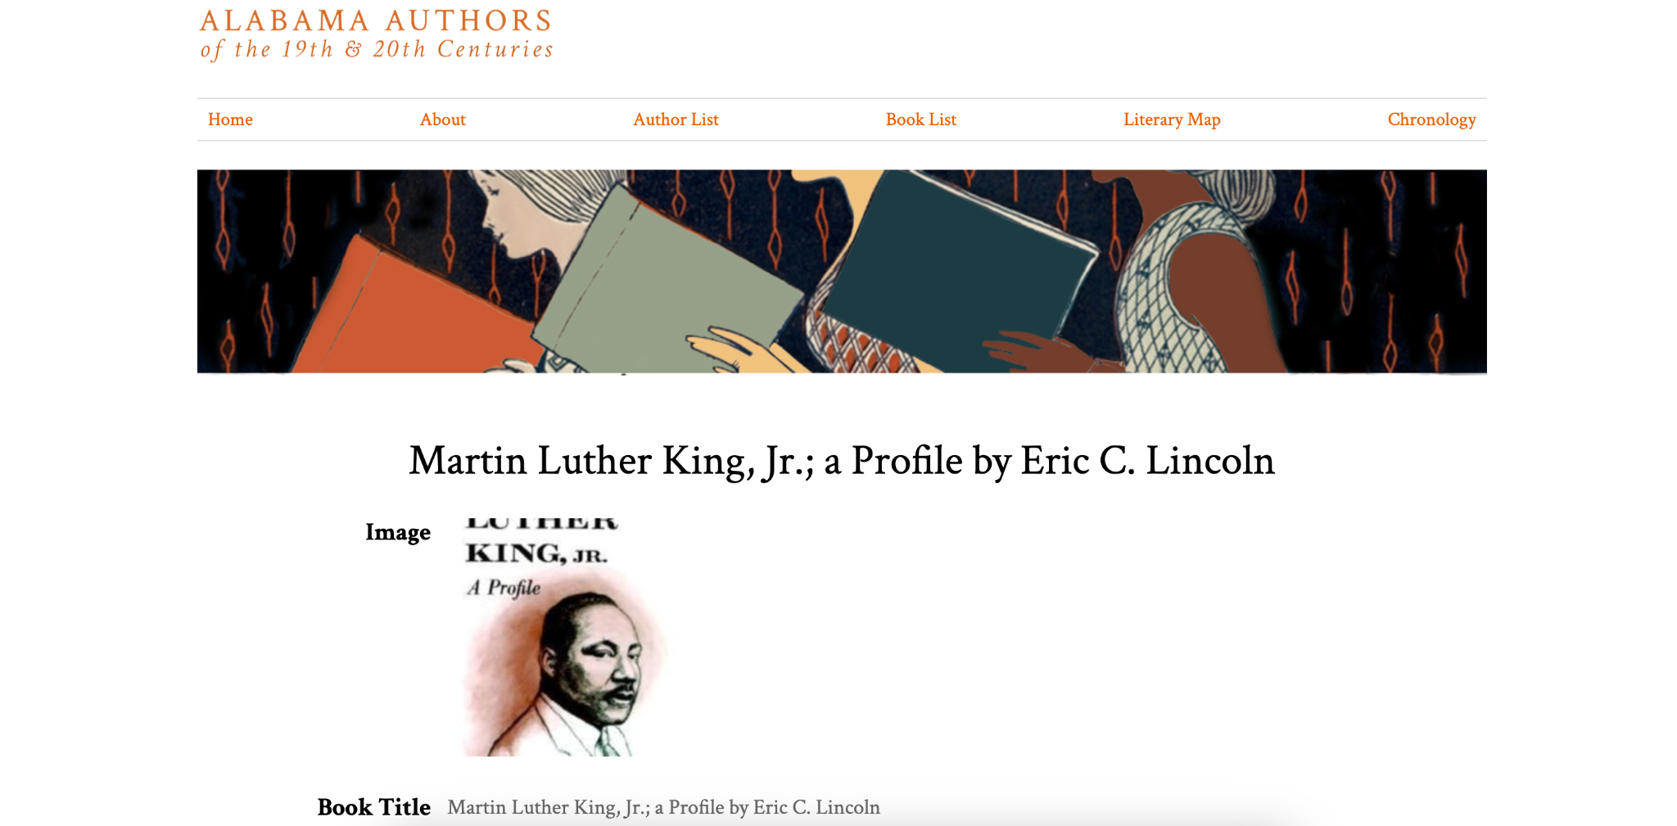
User Story 3.2 Progress
Neatline publication data visualization
Details page for selected publication on Alabama Authors website

Slide 31
3.3 Calendar Wheel Visualization
Amee Kivette
Summary
As an administrator, I want to be able to manage the chronology/timeline data visualization with Omeka Classic to avoid issues with GitHub repository connections.
Description
Sometimes data visualizations are connected to the digital humanities websites by hosting the visualization on a GitHub repository and displaying the result on the website with an iframe. To prevent frustrations associated with this, we must create our visualization using plugins supported by Omeka Classic.
Status
Completed

Slide 32
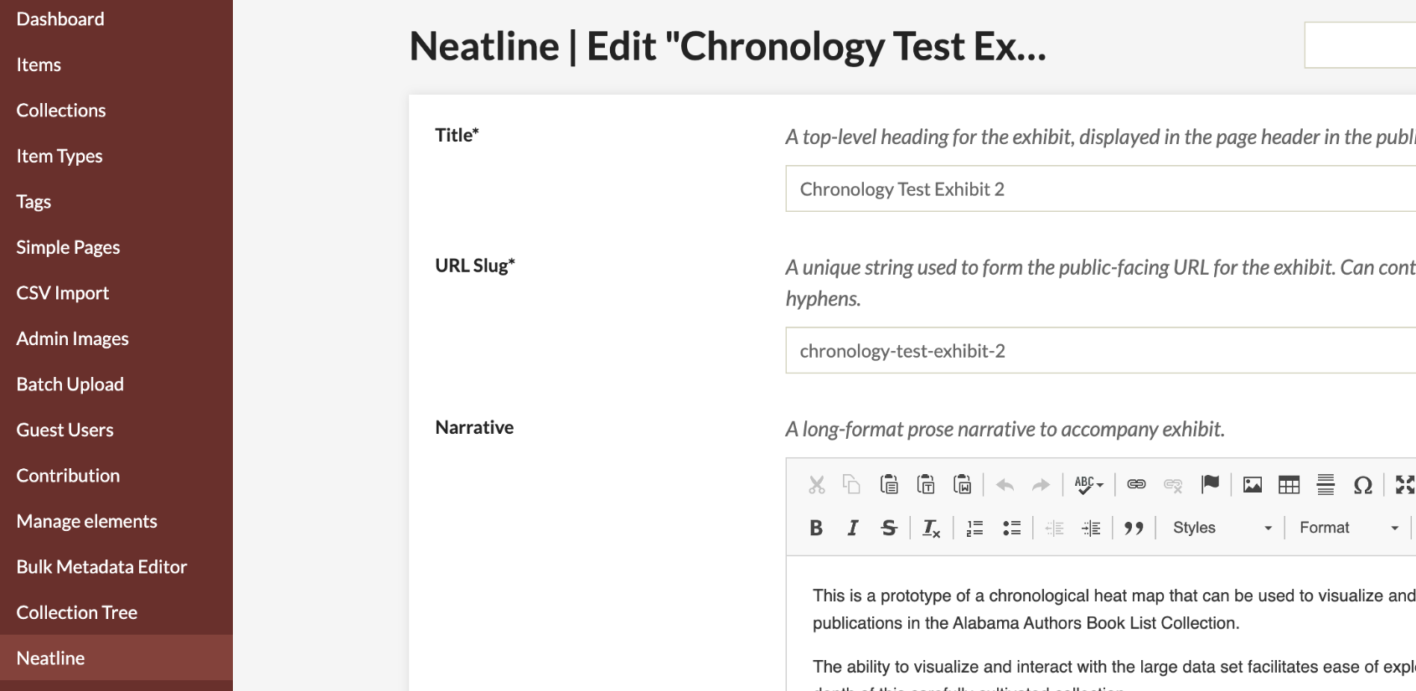
User Story 3.3 Progress
Neatline ‘Exhibit Settings’ view

Slide 33
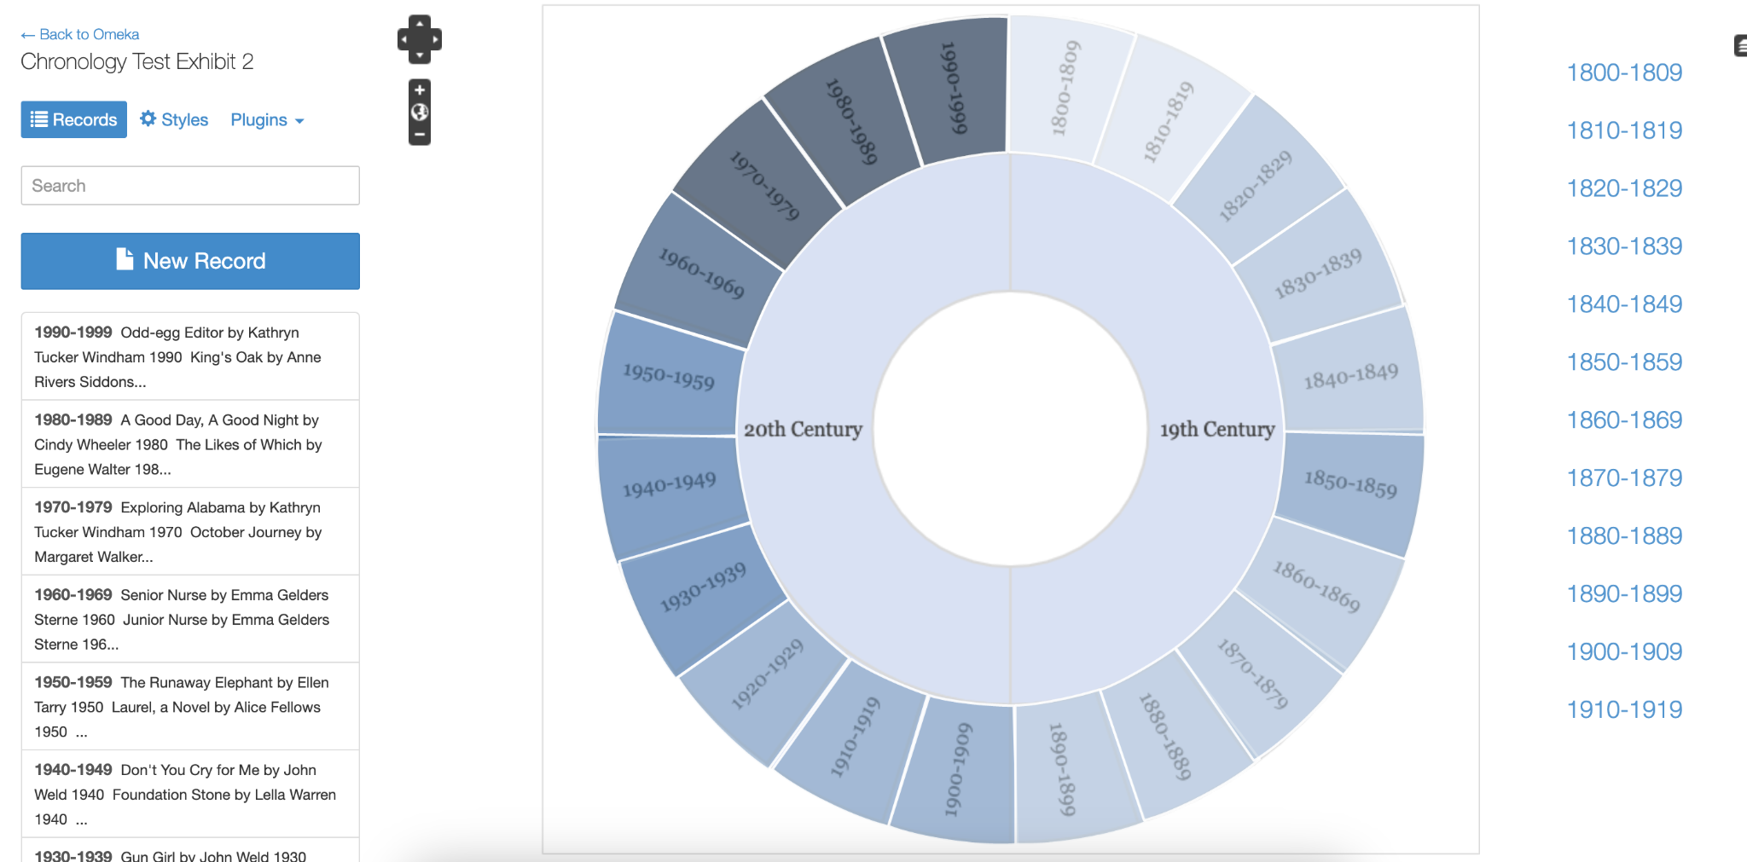
User Story 3.3 Progress
Neatline exhibit editor

Slide 34
3.4 Calendar Wheel Visualization
Amee Kivette
Summary
As a user who experiences a color vision deficiency, I would like to have access to the information on the visualization that is conveyed in color so that I can understand the content.
Description
The heat map on the calendar wheel uses color to convey information about the collection of publications. This color based scheme has the potential to exclude users. Color contrast and easily distinguishable links can help to ensure that the interface is accessible to users with various ranges of color perception.
Status
Completed

Slide 35
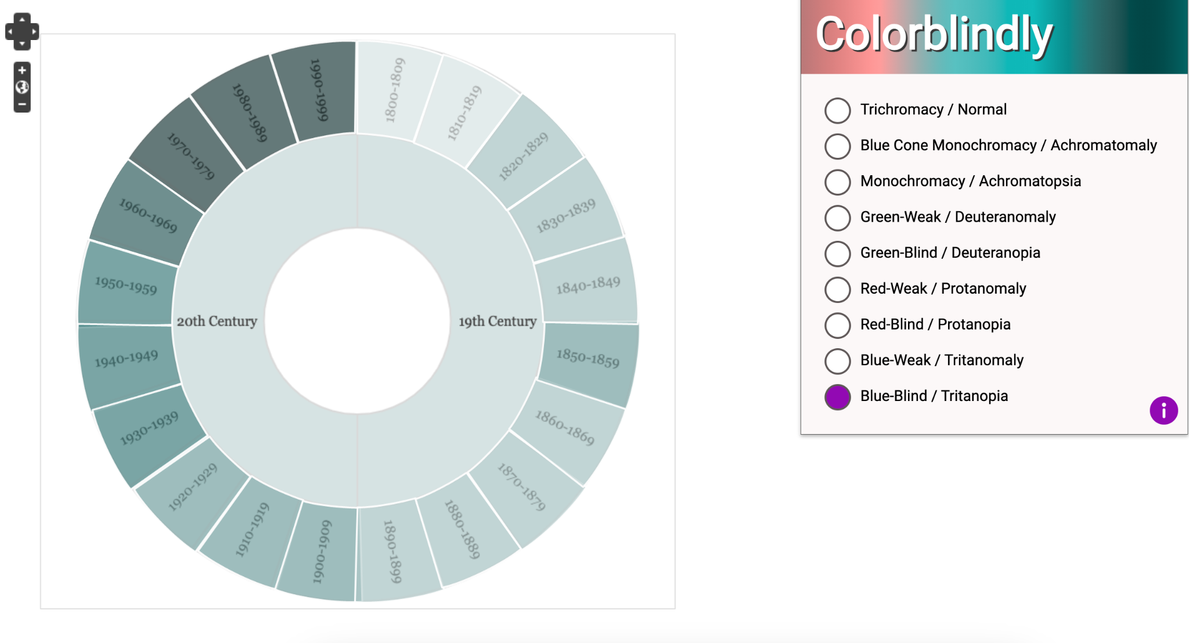
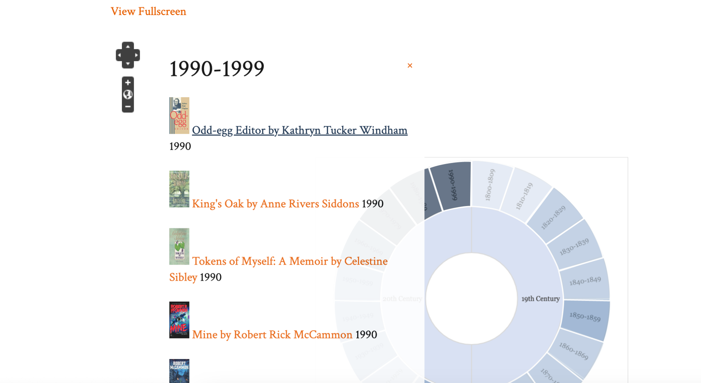
User Story 3.4 Progress
Neatline visualization viewed with Colorblindly extension
Neatline link underlined when hovering

Slide 36
4.0 Birth Date Data
Cady Pridgeon
Summary
As a user, I want to view an author's birth and death dates instead of birth and death years on visualizations to get a complete picture of the author's information.
Description
Only the author's birth and death years are collected and stored in the data. However, birth dates could potentially be scraped from descriptions to generate a more complete profile for each author.
Status
Discarded

Slide 37
5.0 Sunburst Data Visualization
Cady Pridgeon
Summary
As a user, I want to view an author by century and then also explore the author’s publications by year to gain a better understanding of the granular temporal significance of their life and works.
Description
A sunburst-style D3.js visualization could be used to bridge the gap between the two Alabama Authors data collections: authors and books. This can further data exploration and provide users with additional mediums for diving into literary history.
Status
Completed

Slide 38
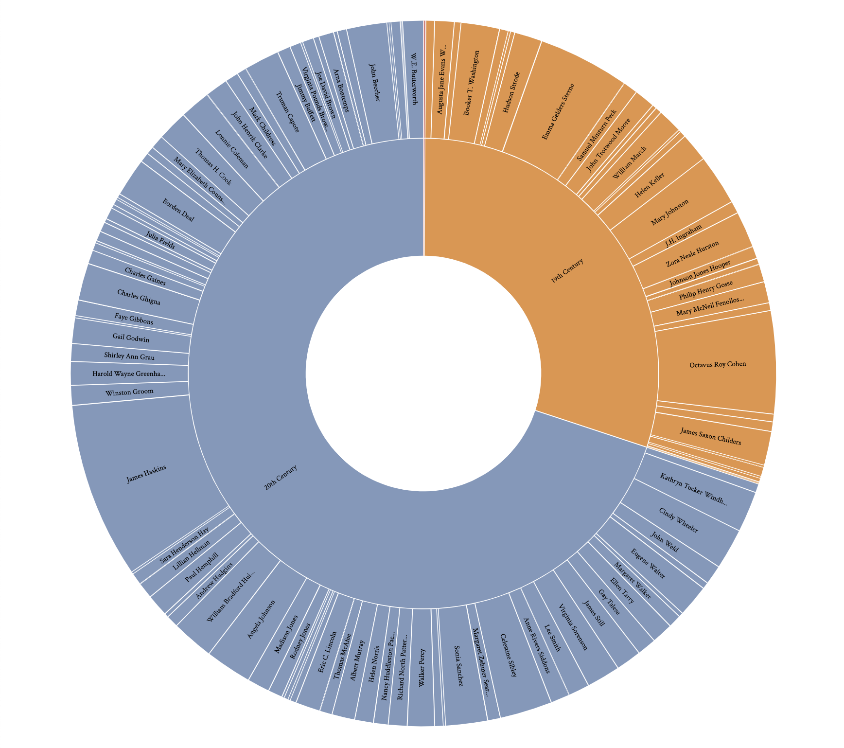
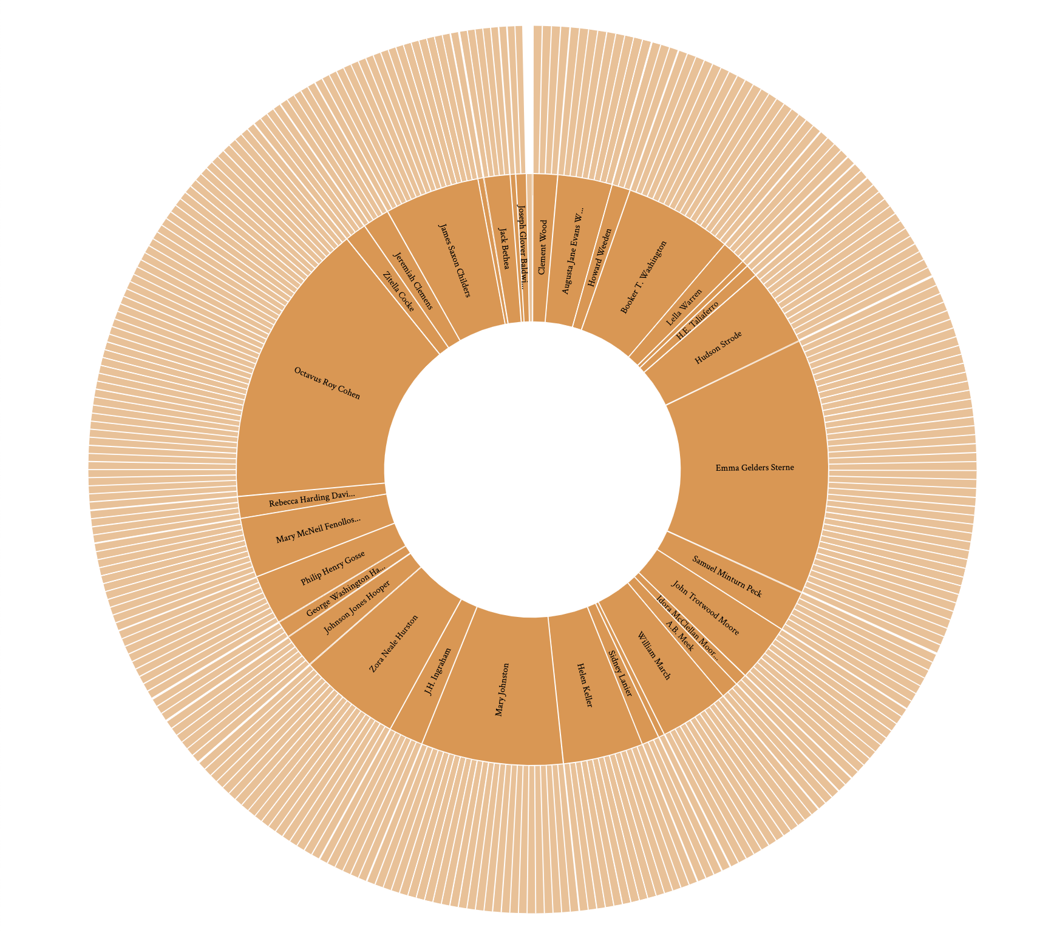
5.0 Sunburst Data Visualization
D3.js sunburst visualization overview
D3.js sunburst visualization with 19th century selection

Slide 39
5.1 Sunburst Data Visualization
Cady Pridgeon
Summary
As a user, I want to be able to see author names, birth years, death years, book title, publication years, and pictures when I hover over areas to quickly learn about the author without having to navigate to their details page.
Description
Allowing users to gain a preview of author or book information with a hover tooltip enables them to quickly learn about the authors or books available within a certain time period. Additionally, for small sections, this allows users to preview the name attached to the section.
Status
Completed

Slide 40
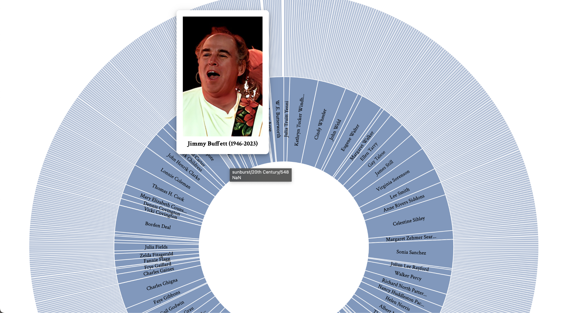
5.1 Sunburst Data Visualization
D3.js sunburst author tooltip on hover

Slide 41
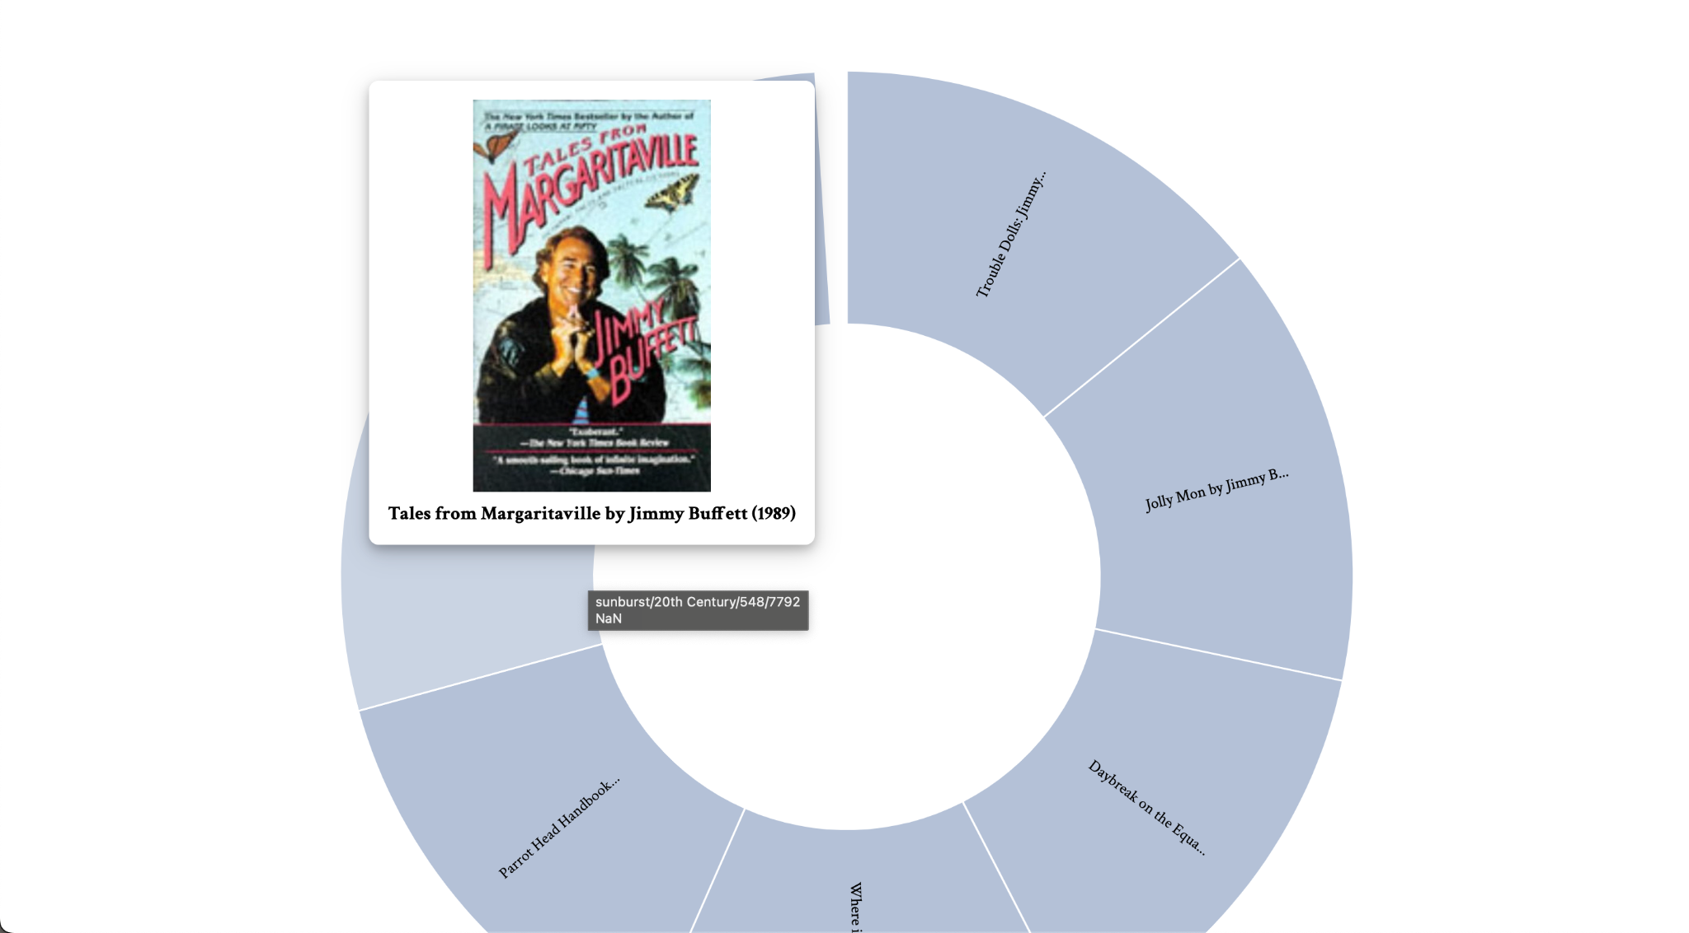
5.1 Sunburst Data Visualization
D3.js sunburst book publication tooltip on hover

Slide 42
5.2 Sunburst Data Visualization
Cady Pridgeon
Summary
As a user, I want to be able to click on a section and navigate to the internal author or books page to explore deeper into the website.
Description
Allowing users to explore deeper into the Alabama Authors website ensures they are making the maximum use of the data available to them, and also showcases the seamless interfacing between the external visualization and internal resources.
Status
Completed

Slide 43
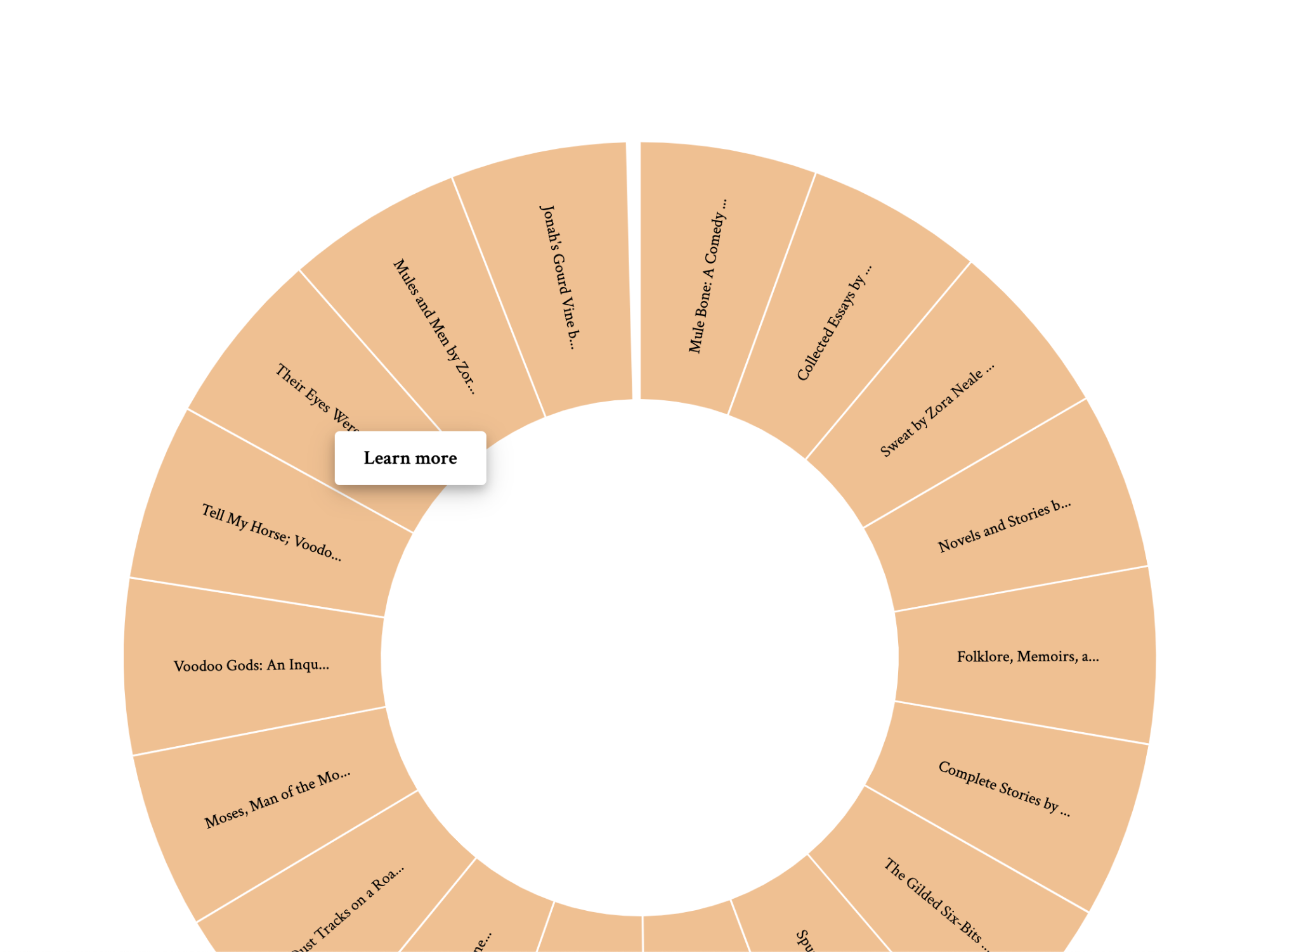
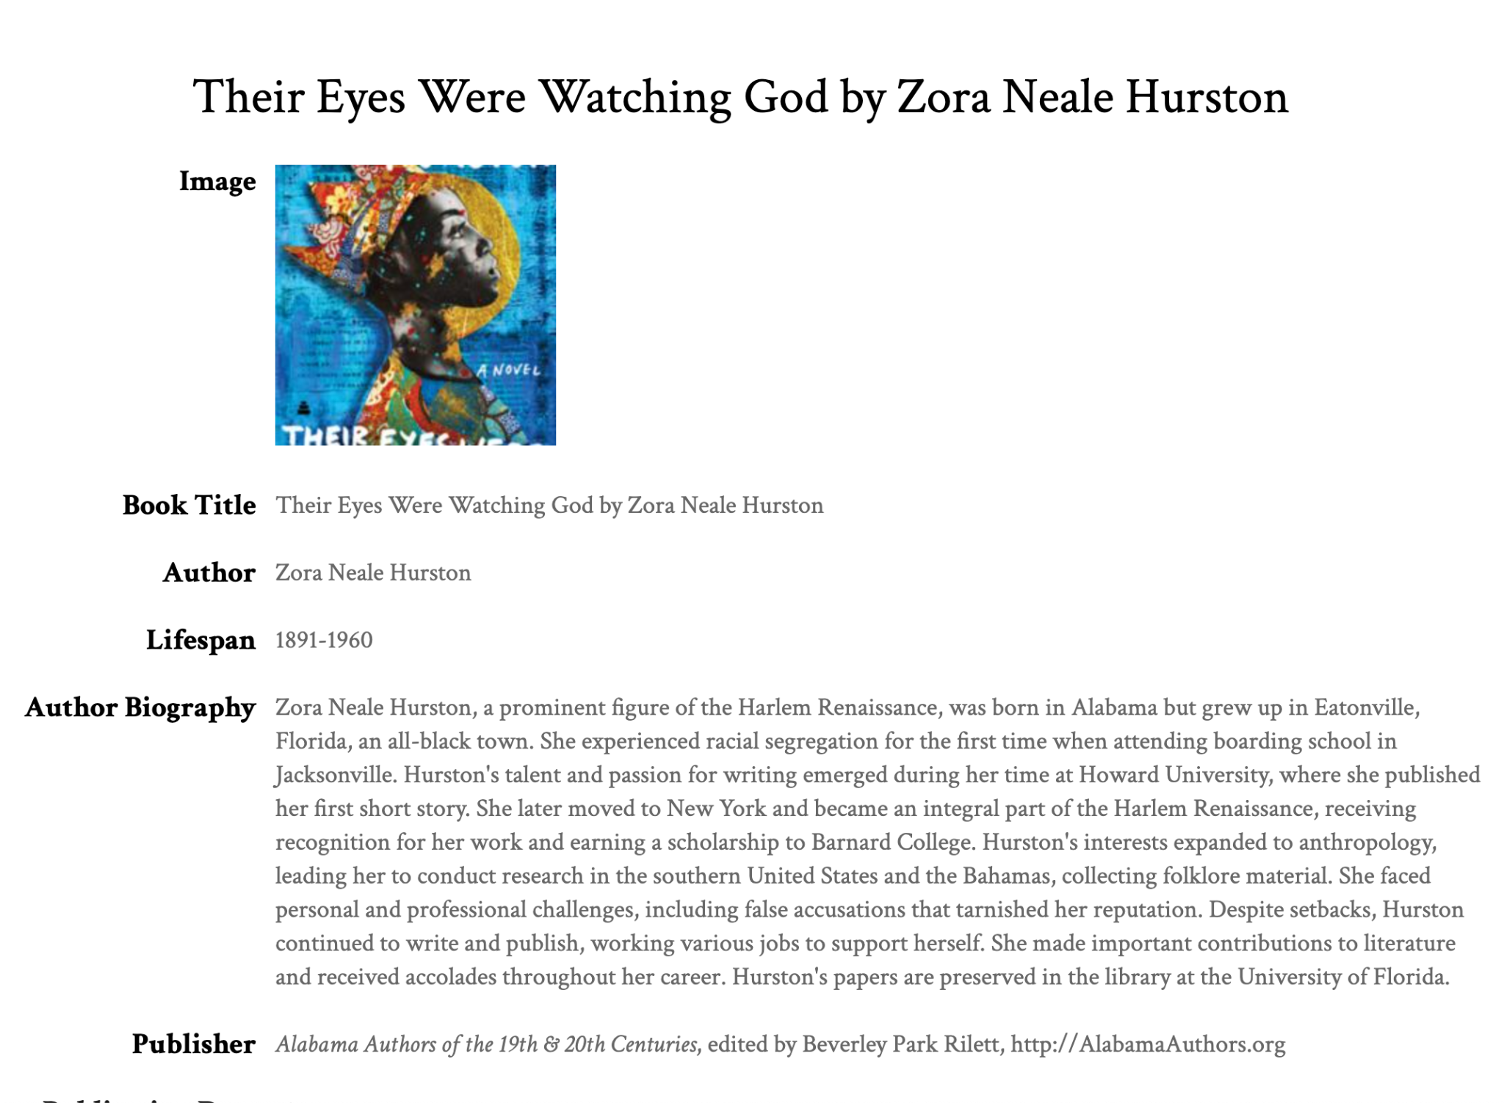
5.2 Sunburst Data Visualization
D3.js sunburst book publication right click
Alabama Authors book publication details page

Slide 44
5.3 Sunburst Data Visualization
Cady Pridgeon
Summary
As a user, I want to be able to export my visualization to keep for my records to conduct research or simply save my findings.
Description
Being able to quickly export a complex visualization into an image or PDF supports users in research and grants them a way to save progress after utilizing visualizations on the website.
Status
Completed

Slide 45
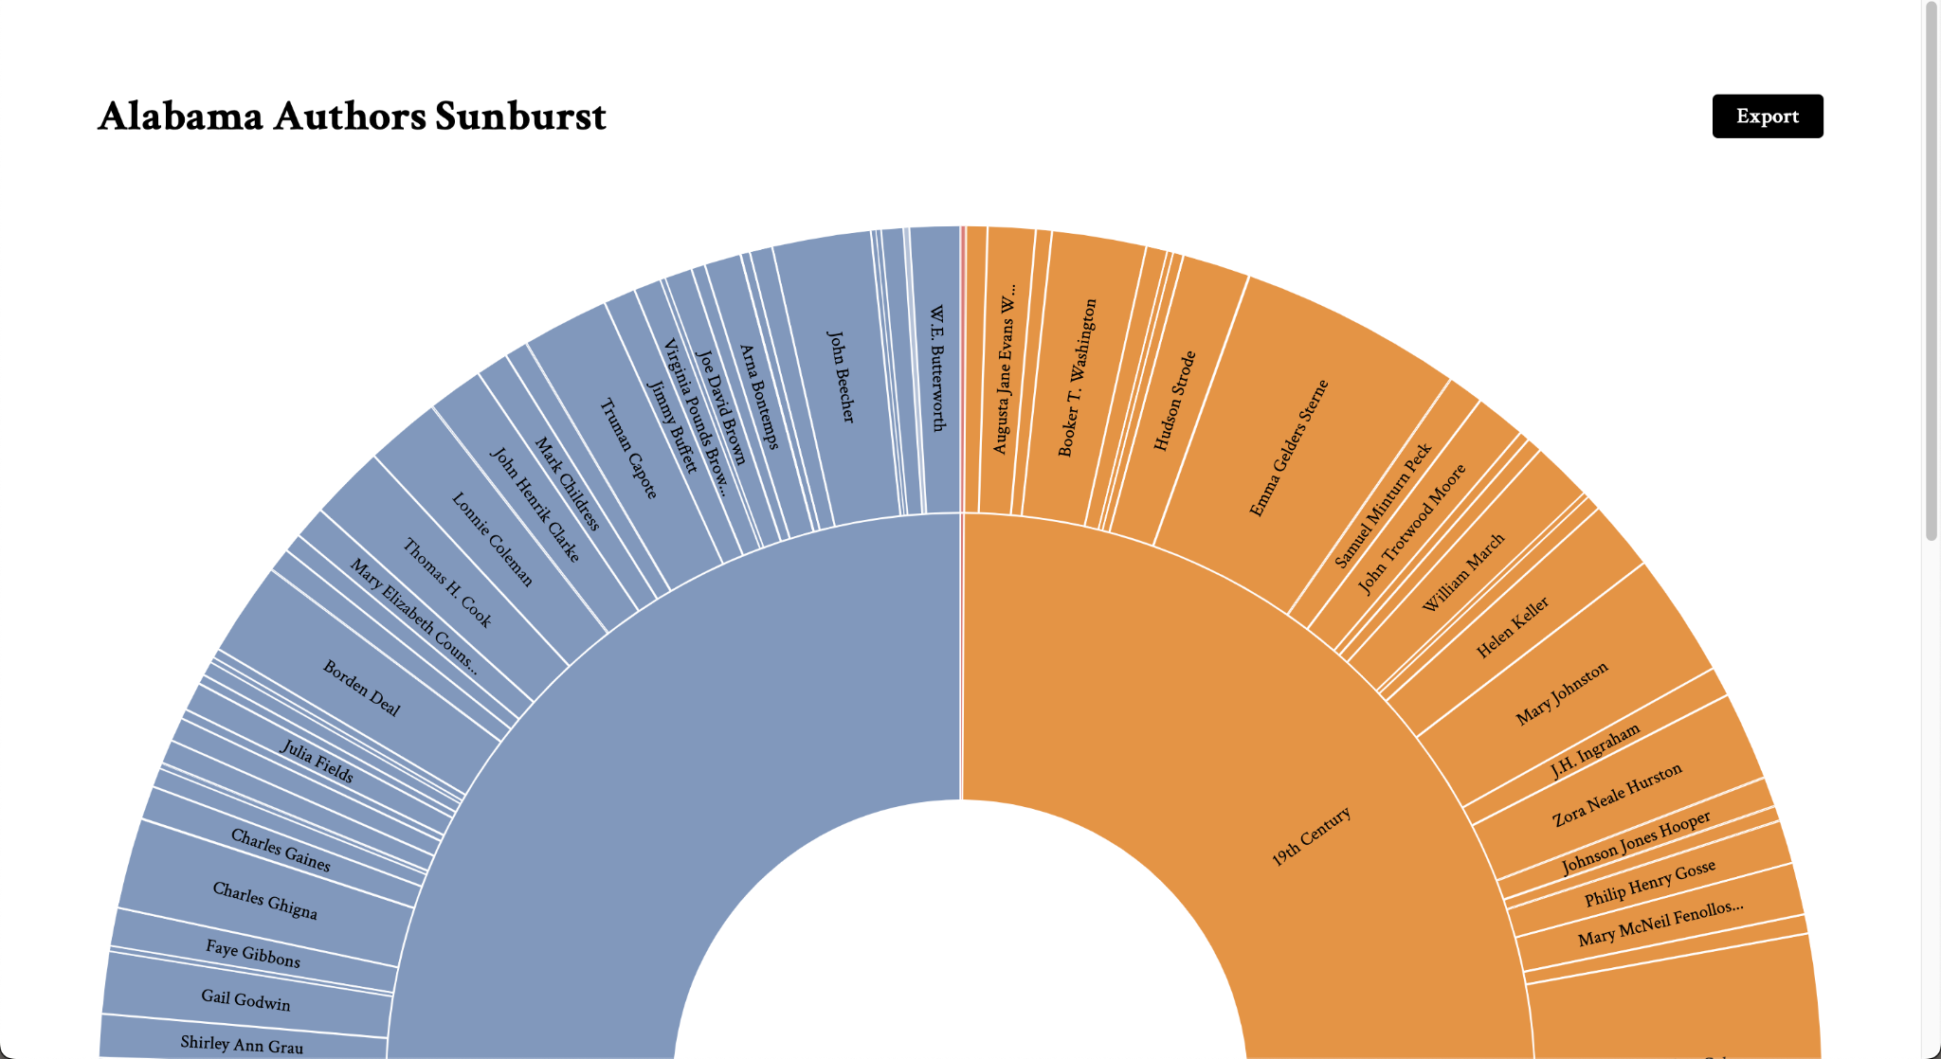
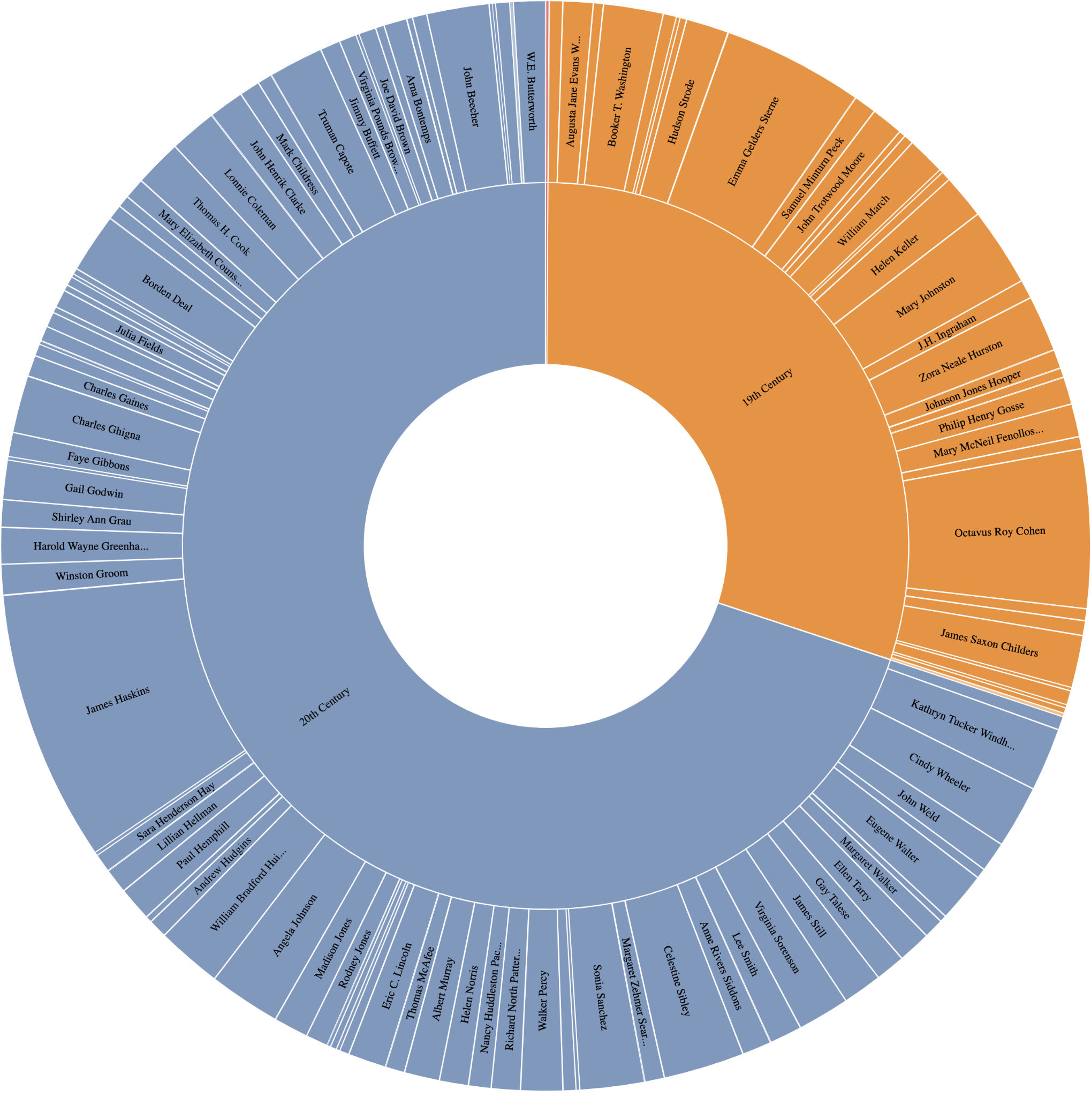
5.3 Sunburst Data Visualization
D3.js sunburst export button
D3.js sunburst export output image

Slide 46
5.4 Sunburst Data Visualization
Cady Pridgeon
Summary
As a user, I want to be able to access the sunburst visualization from any device, such as a computer, tablet, or phone, and experience an accessible data visualization.
Description
The data visualization should be responsive, supporting users from any device, including a mobile phone.
Status
Completed

Slide 47
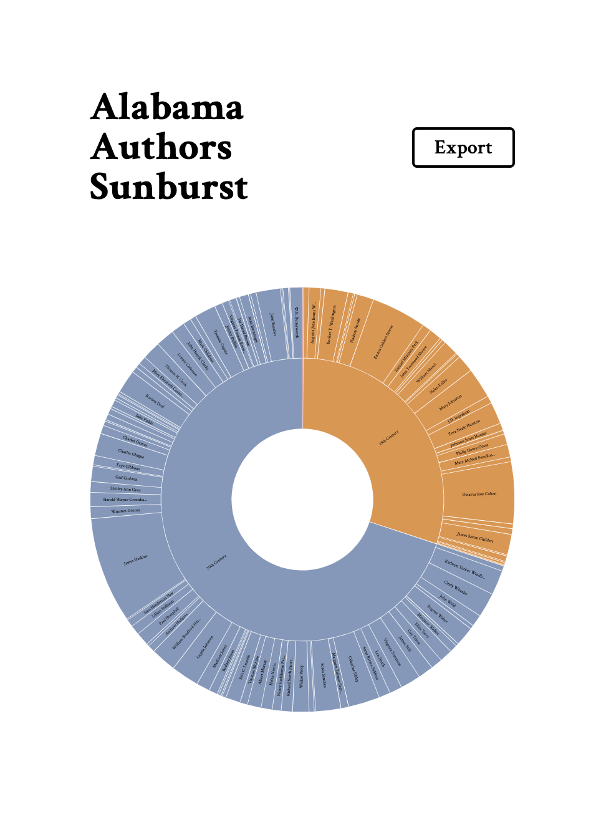
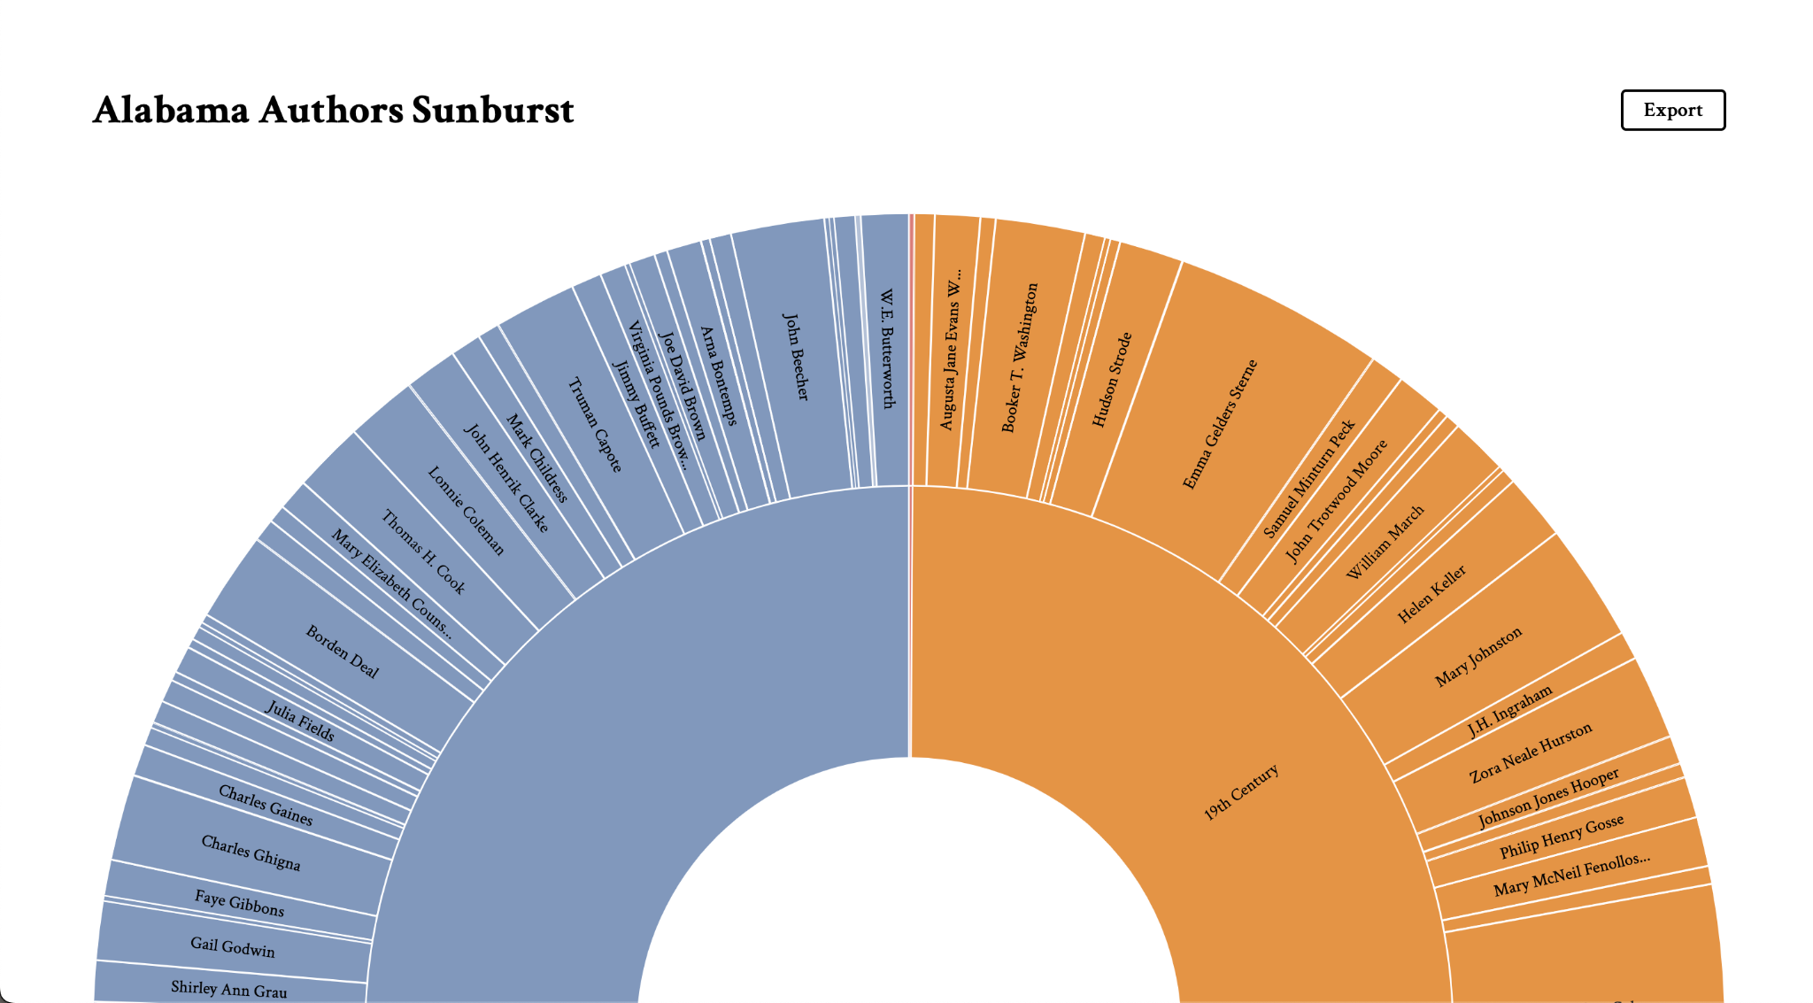
5.4 Sunburst Data Visualization
D3.js sunburst visualization on desktop
D3.js sunburst visualization on mobile

Slide 48
5.5 Sunburst Data Visualization
Cady Pridgeon
Summary
As a user, I want to experience an accessible user interface on the Alabama Authors website to ensure my abilities do not interfere with viable interactions on the website.
Description
Color contrast, tab index, and verbiage are a few aspects that make an interface accessible and inclusive. It is crucial that anyone, regardless of their abilities, should be able to access and navigate the website and visualizations with ease.
Status
Completed

Slide 49
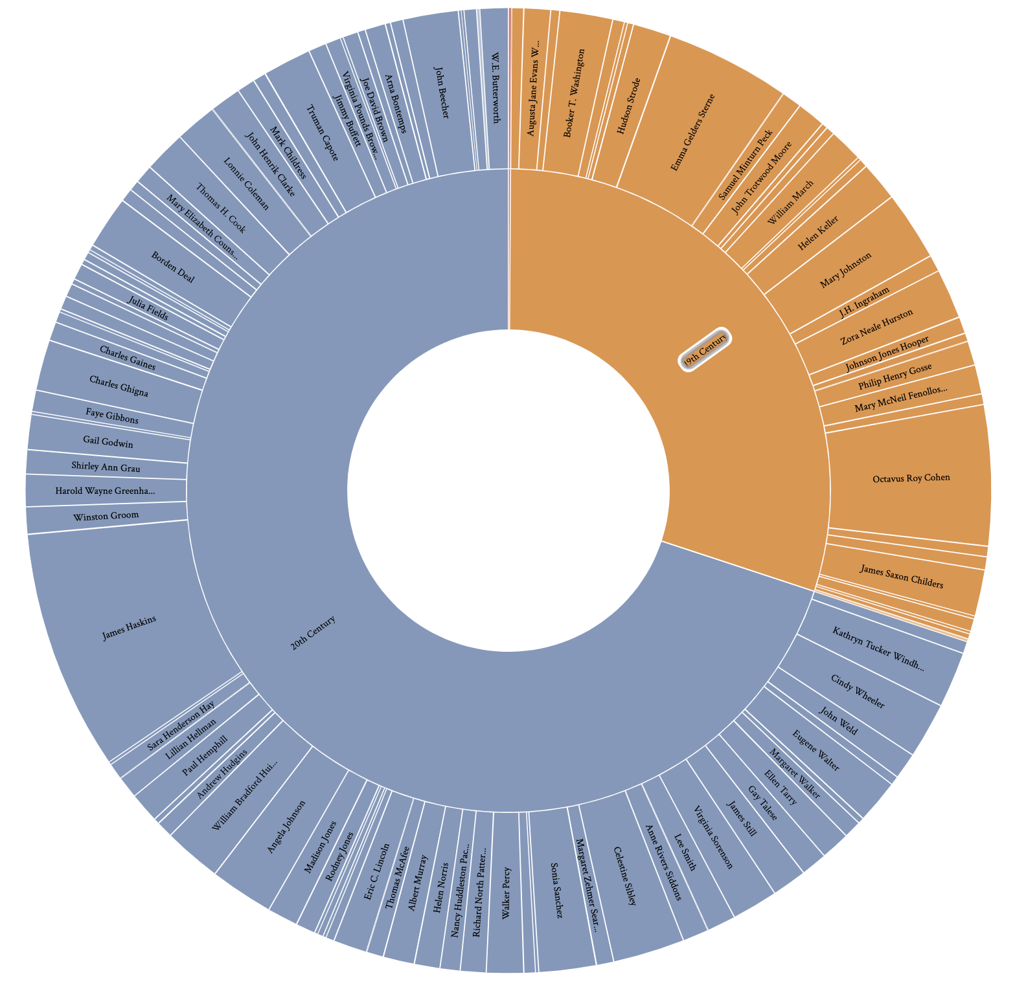
5.5 Sunburst Data Visualization
Using tab index to navigate the D3.js sunburst visualization

Slide 50
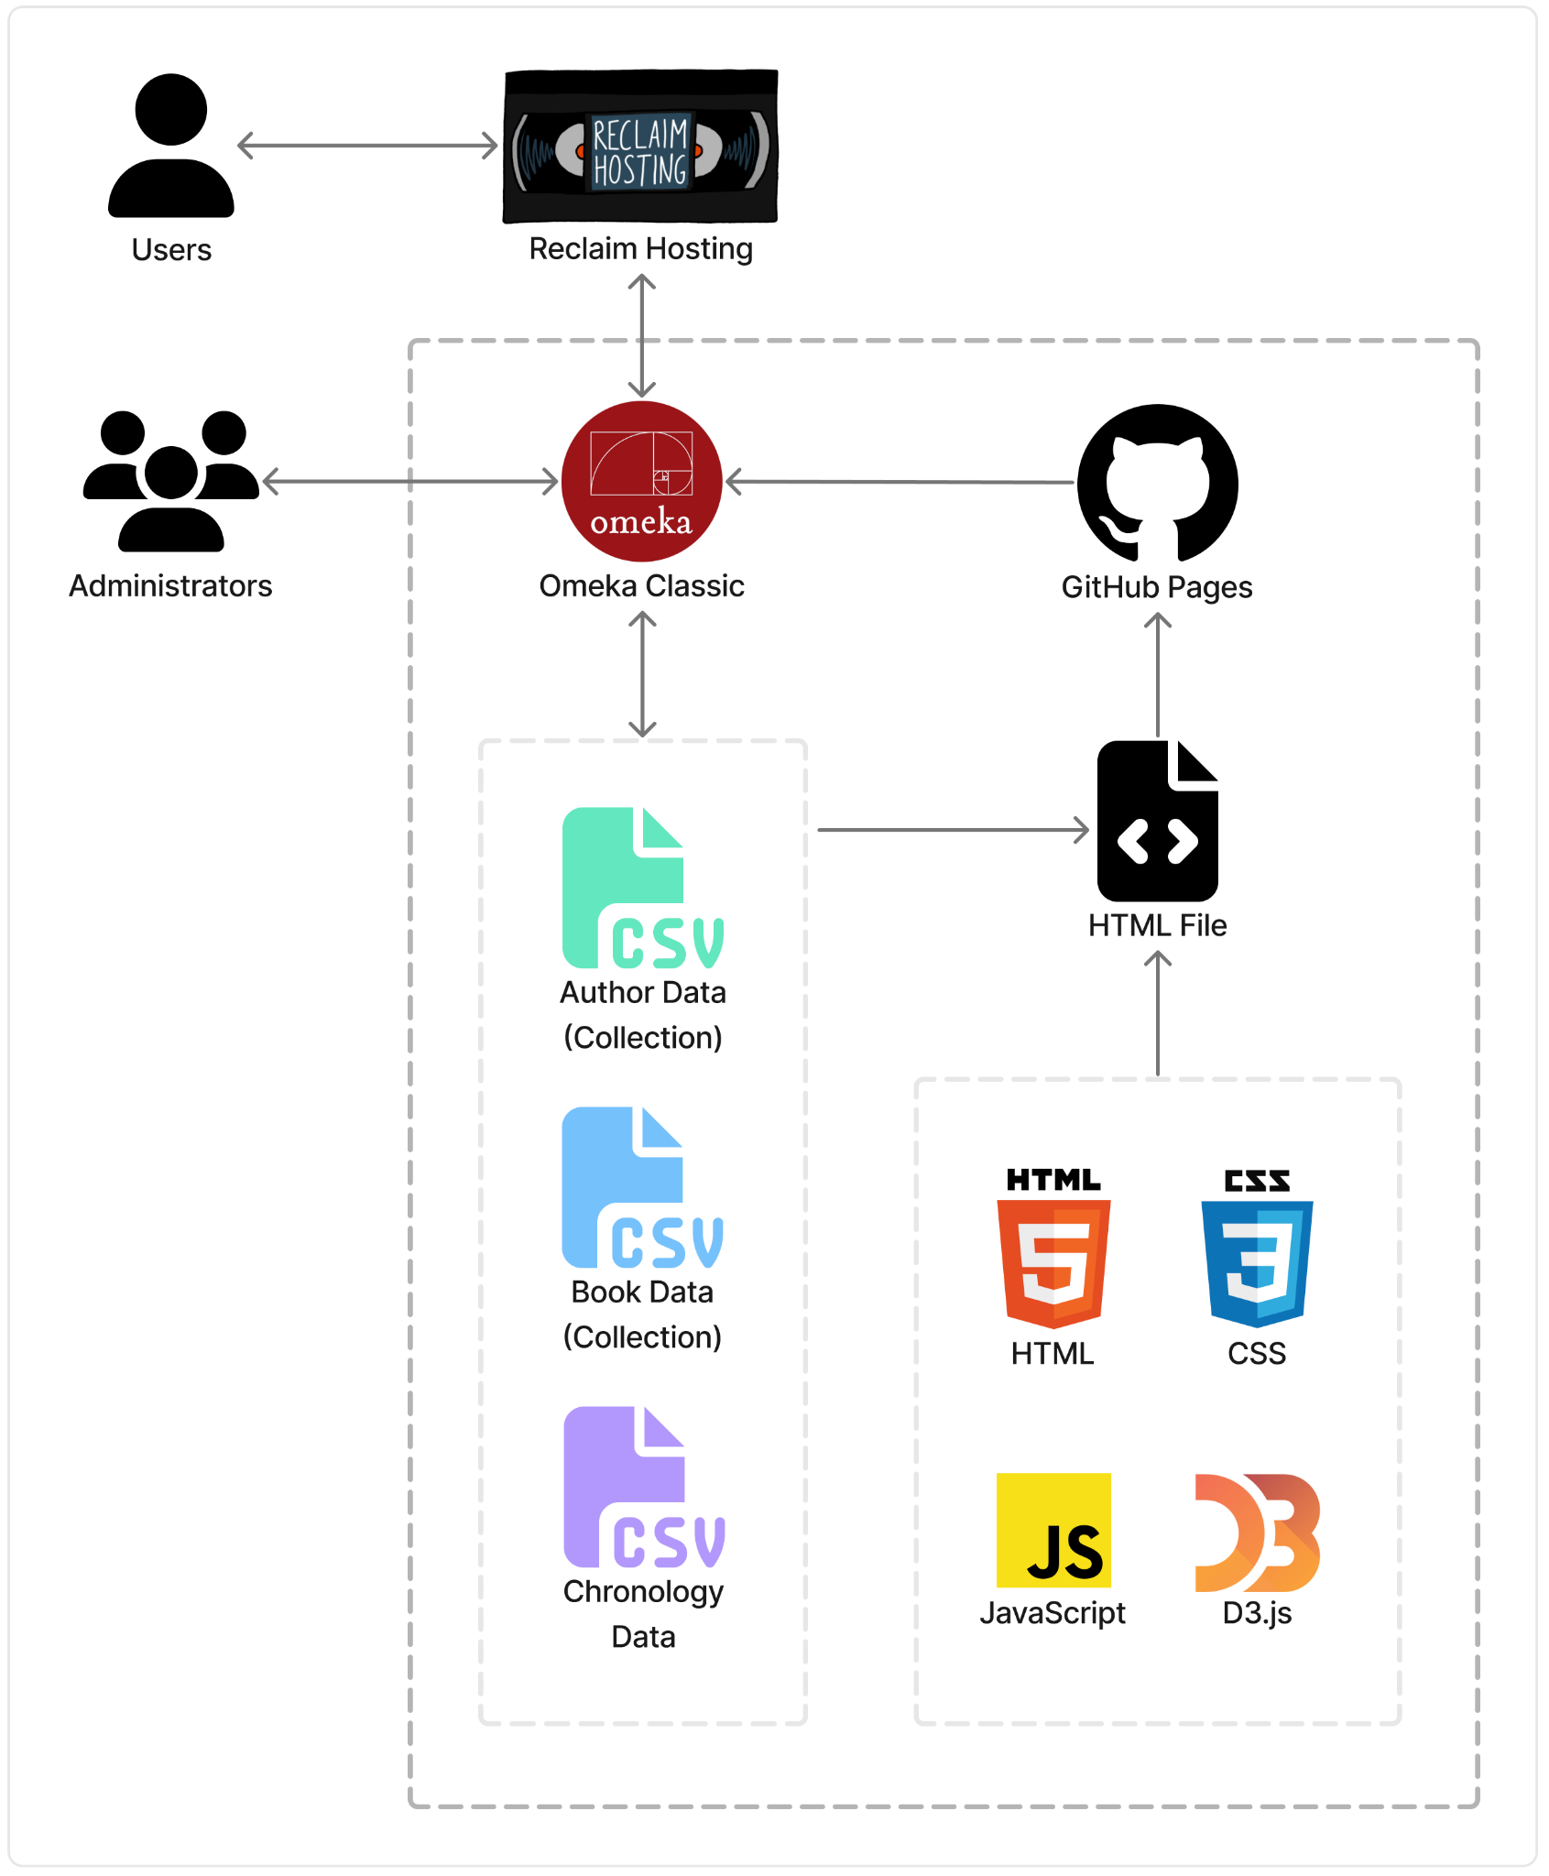
Design
Cady Pridgeon
Architecture
Reclaim Hosting
Omeka Classic
Author Data CSV files
AL Author Collection
AL Book Collection
Chronology Data (1700)
GitHub Pages
HTML File
HTML, CSS, JavaScript
D3.js
Architecture diagram, technology flow chart

Slide 51
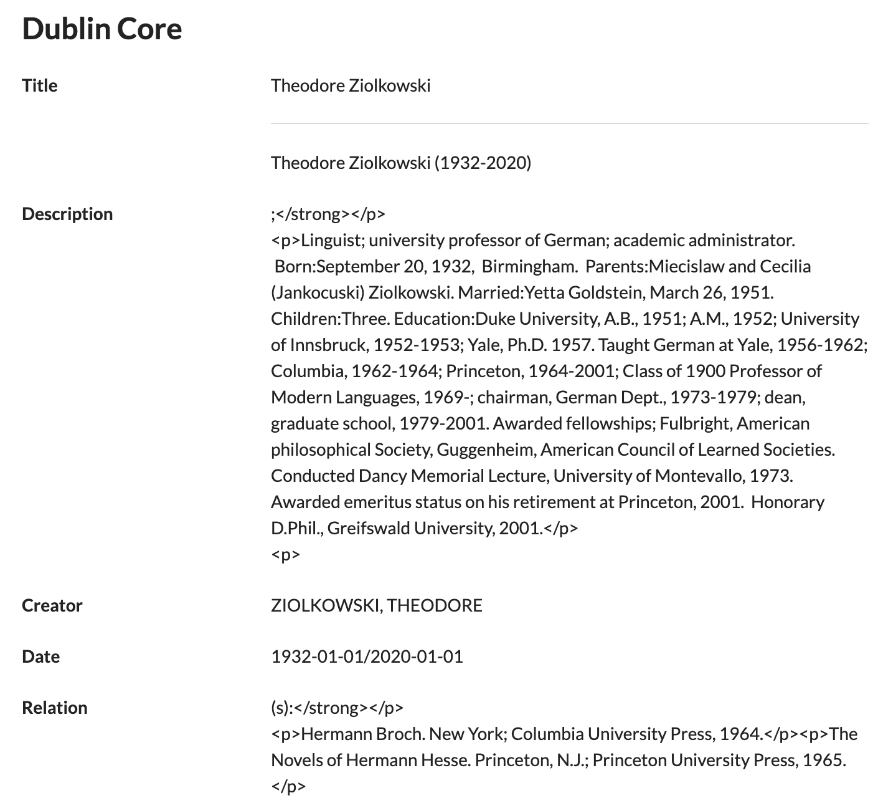
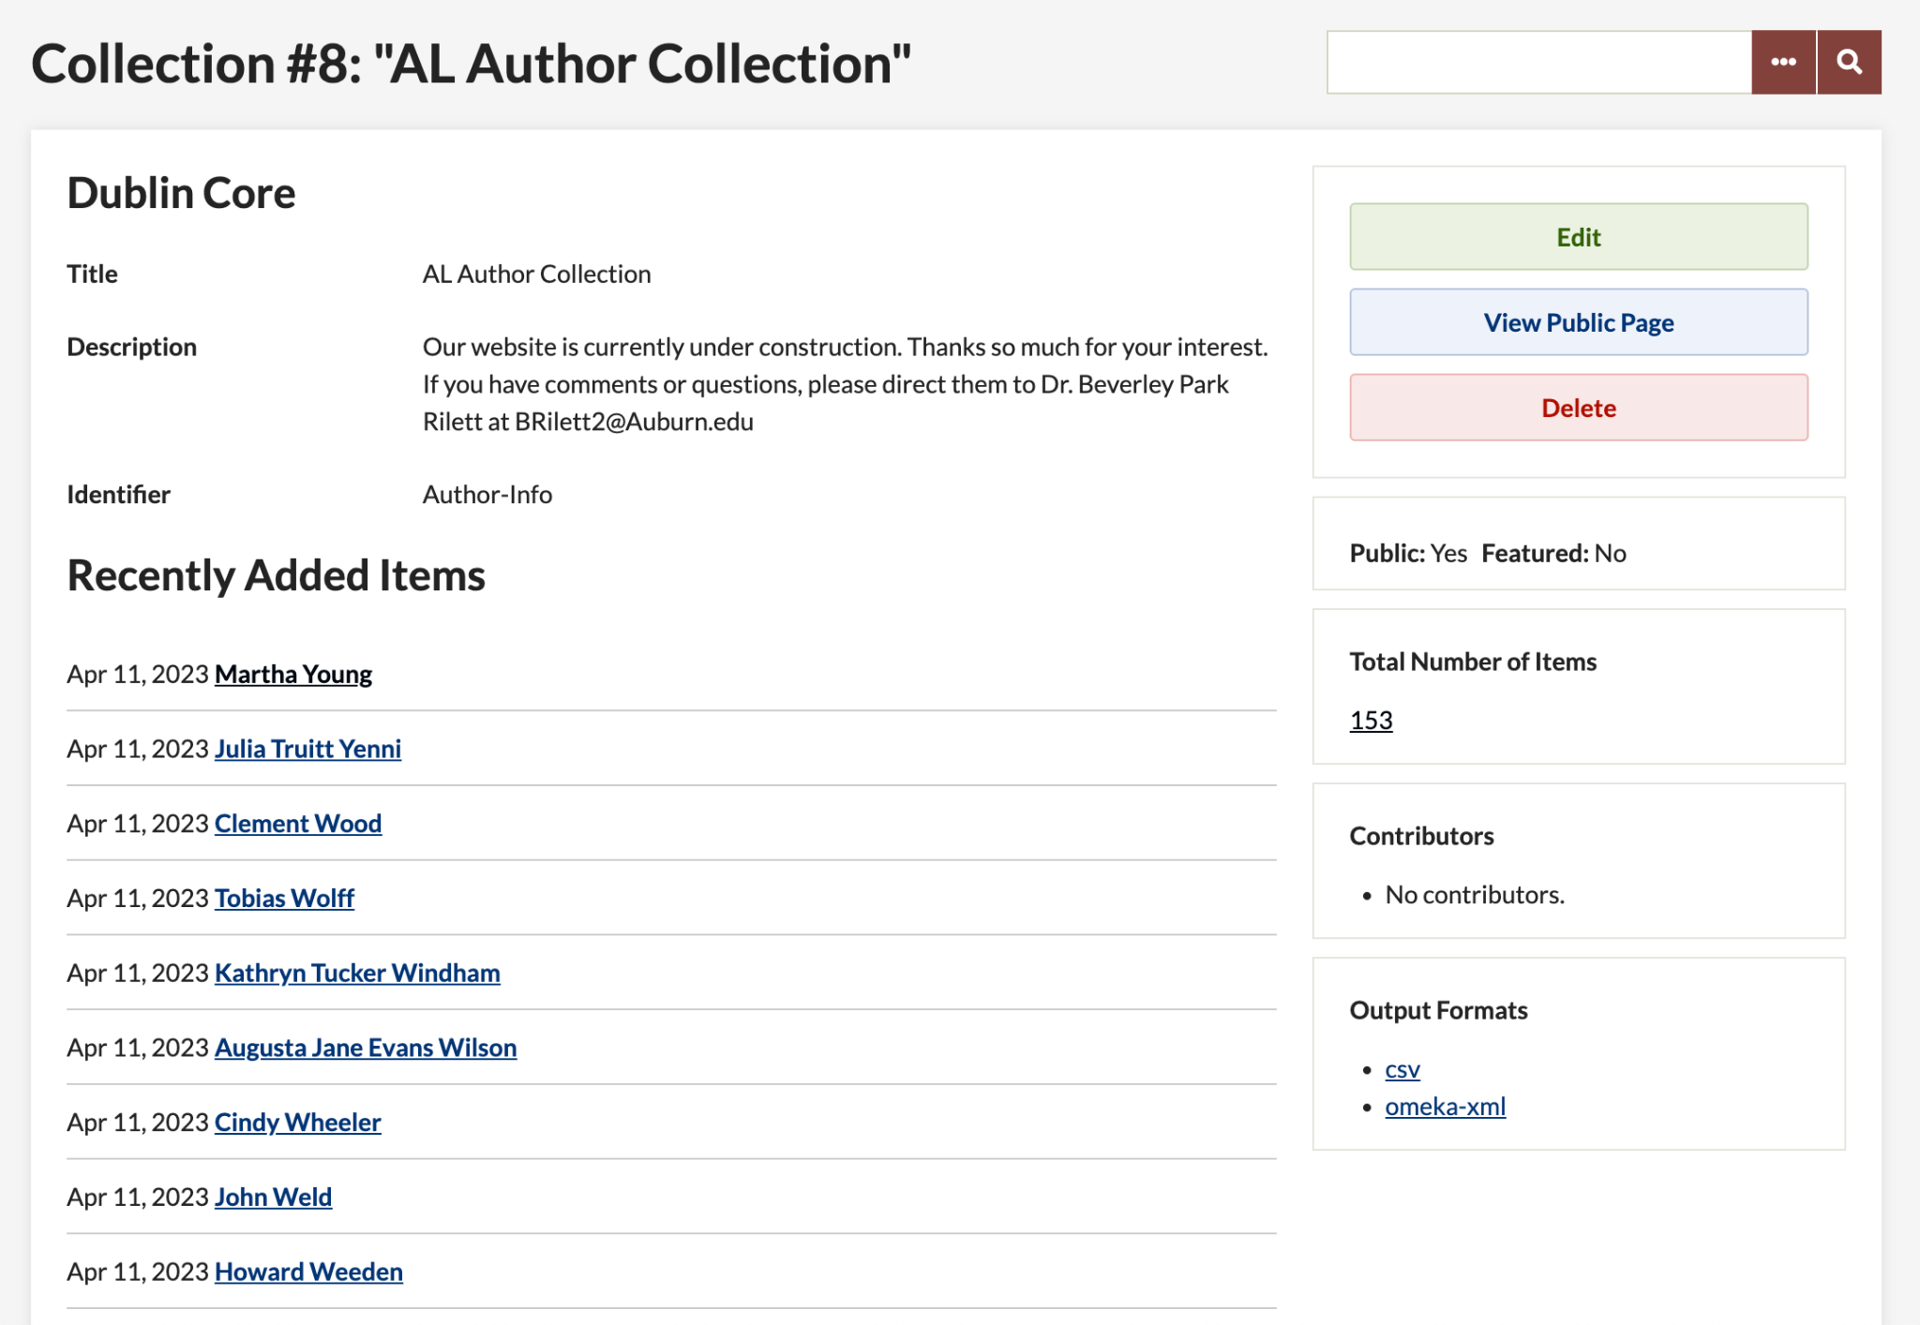
Design
AL Author Collection
Dublin Core metadata fields on Omeka Classic

Slide 52
Design
Neatline calendar wheel heatmap visualization

Slide 53
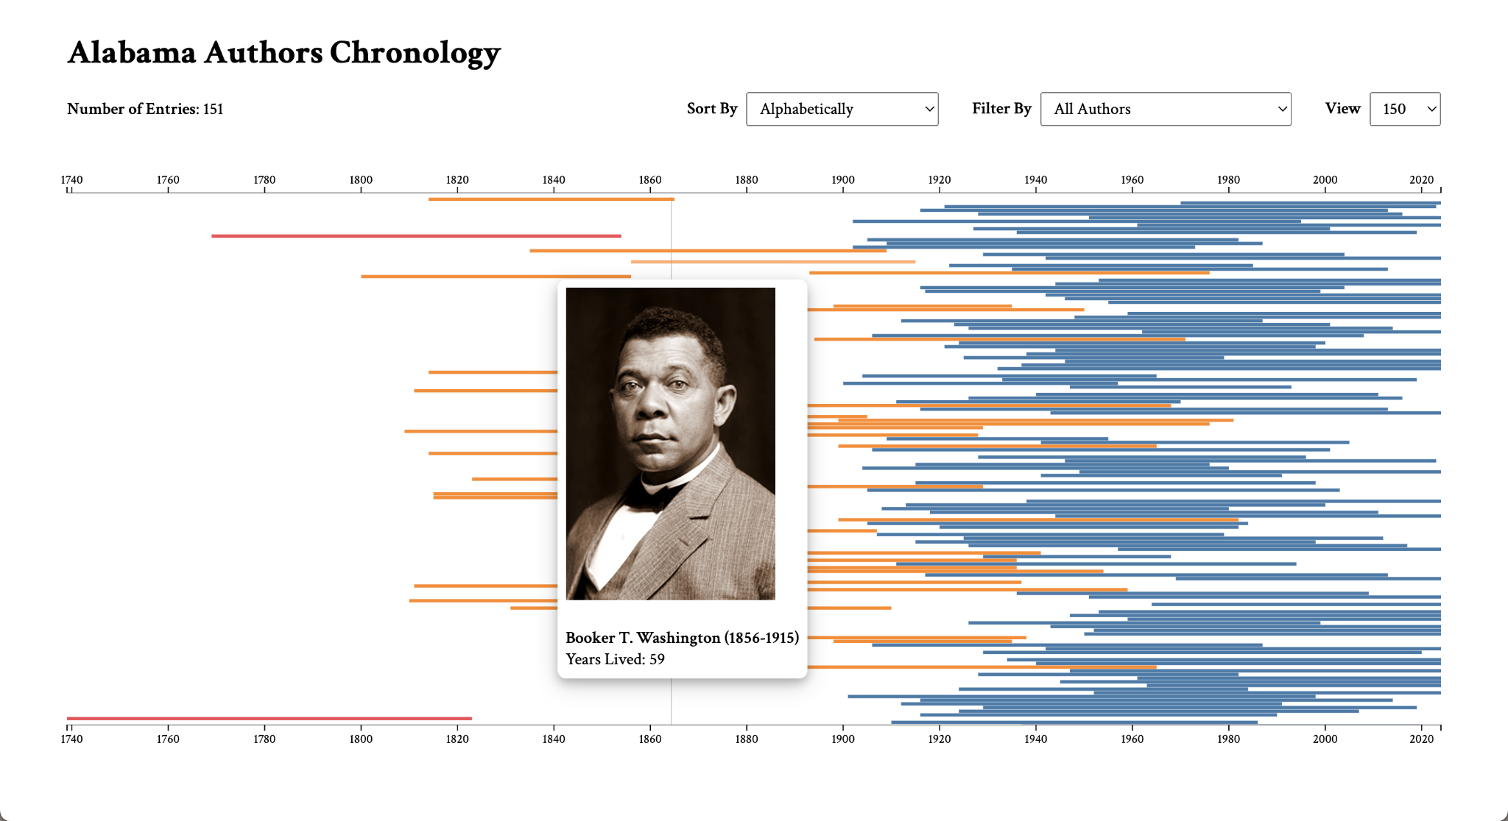
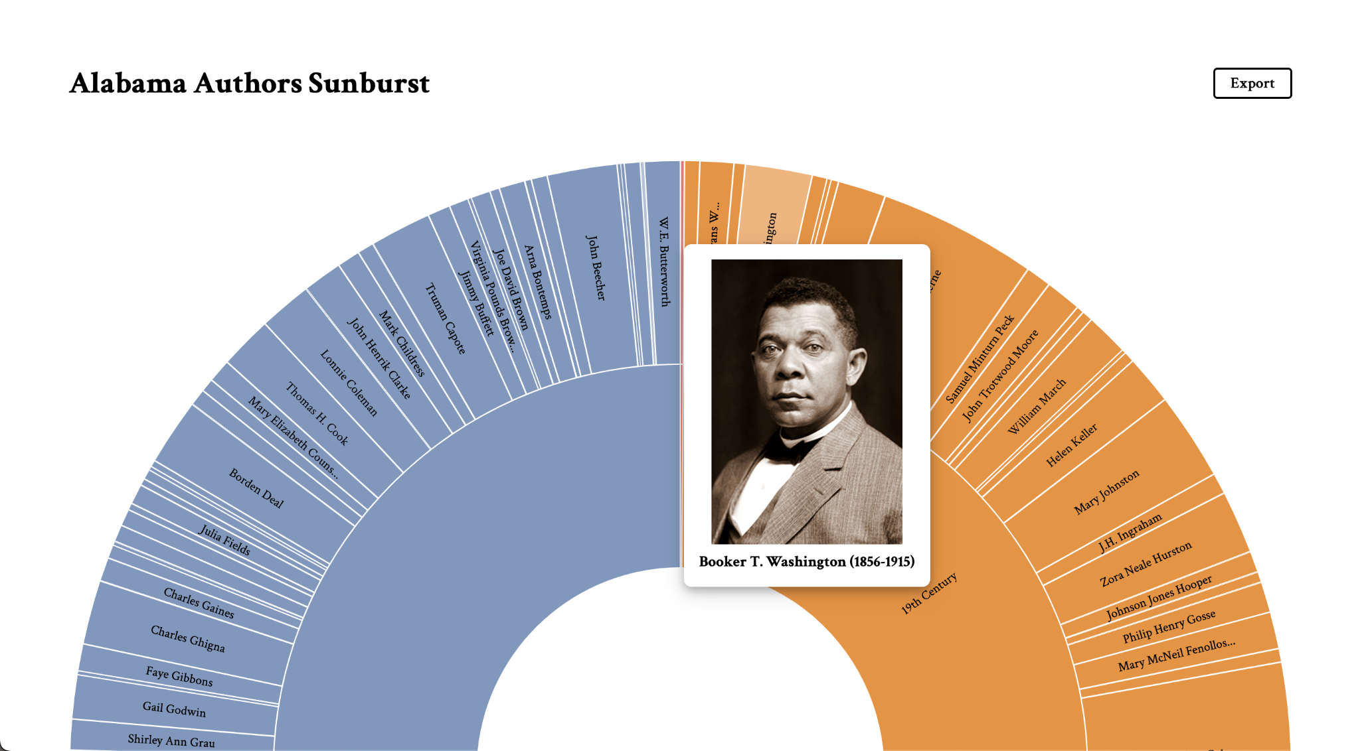
Design
D3.js bar chart chronology visualization
D3.js bar chart sunburst visualization

Slide 54
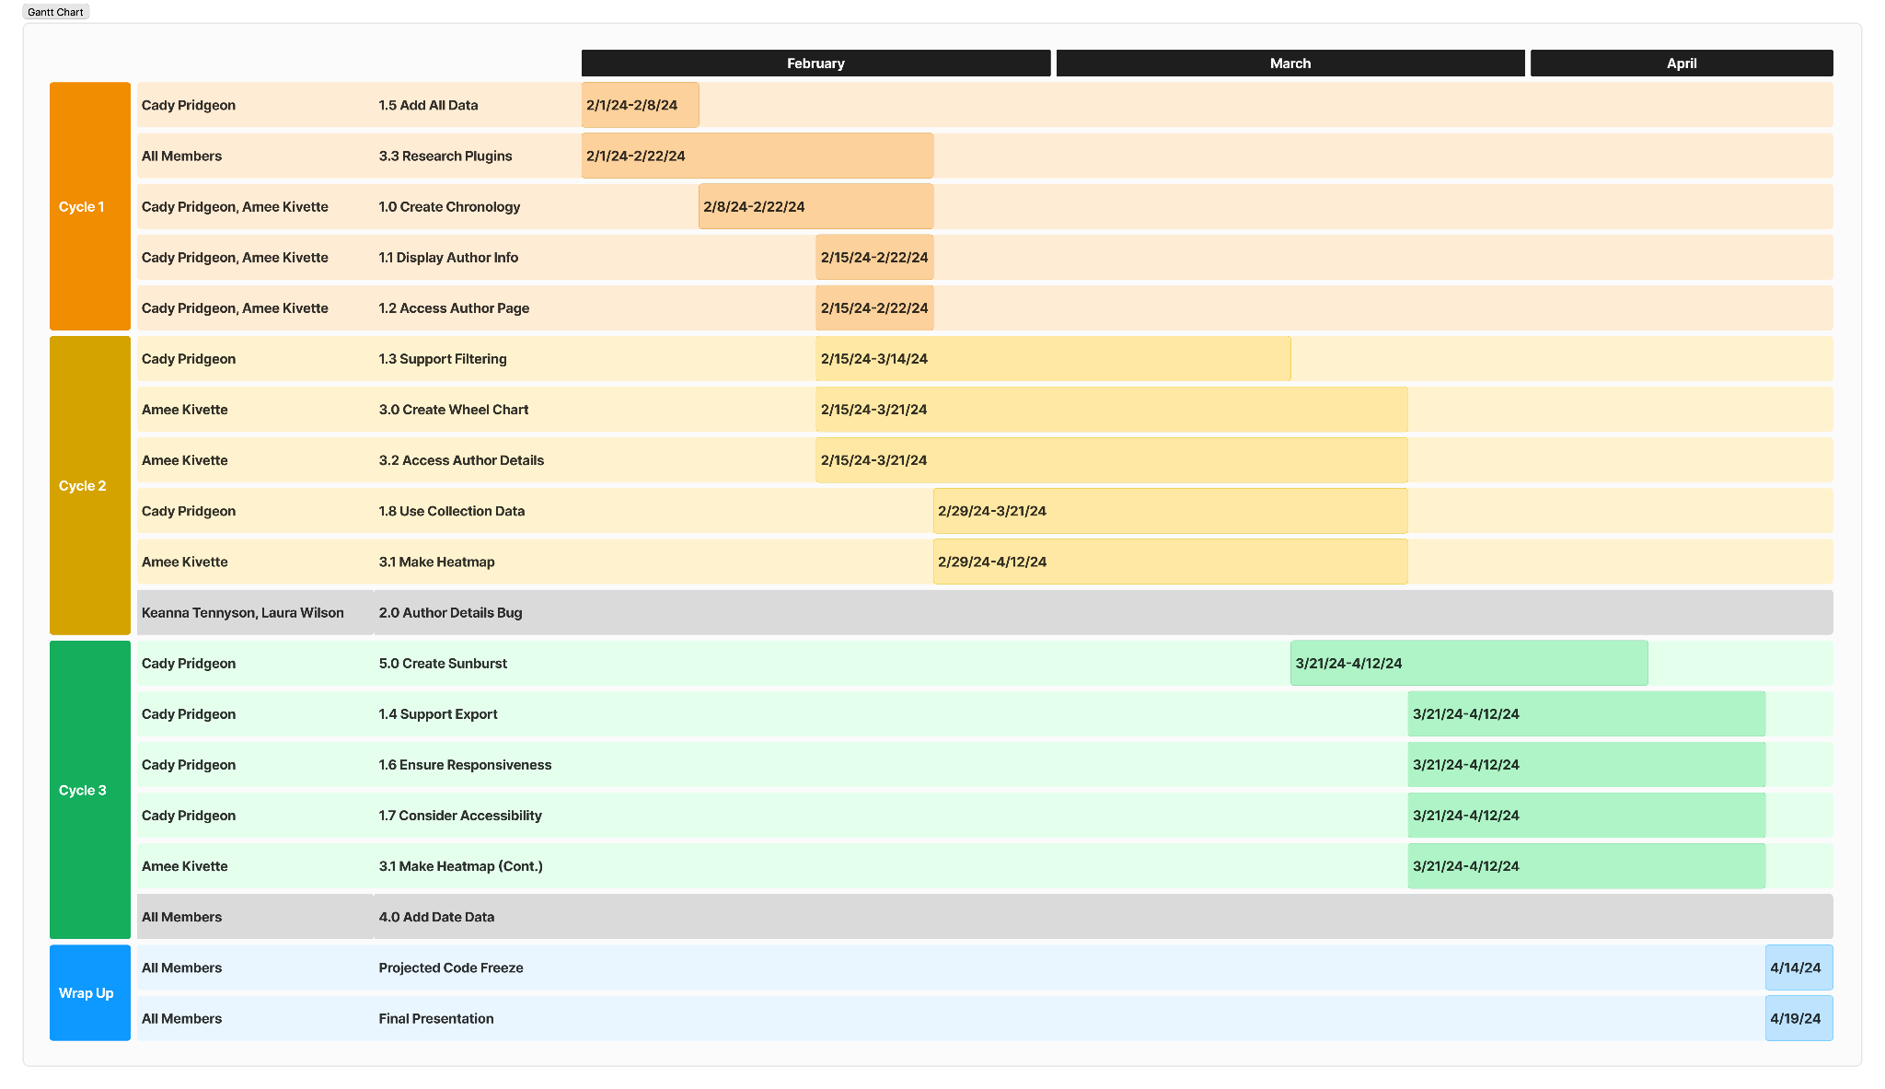
Process
Cady Pridgeon
Sponsor Communication
Weekly in-person meetings
Open email communication
Project web developer for technical questions
Team Communication
Weekly team check-ins
Text message for general purposes
Zoom for meetings
Gantt chart with estimated development schedule
User Story, Task, & Issue Management
Assignments split between members
Tasks created on a Kanban board in Notion
Problems are discussed with the team

Slide 55



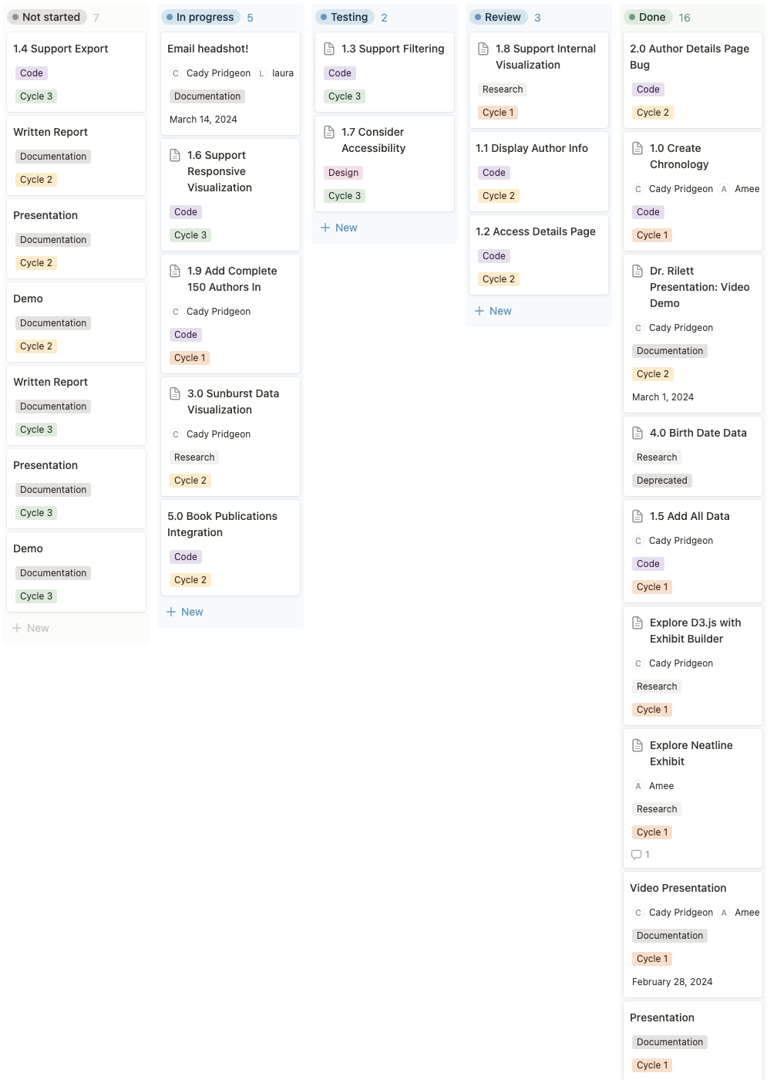
Process
Kanban Board on Notion for team task management

Slide 56

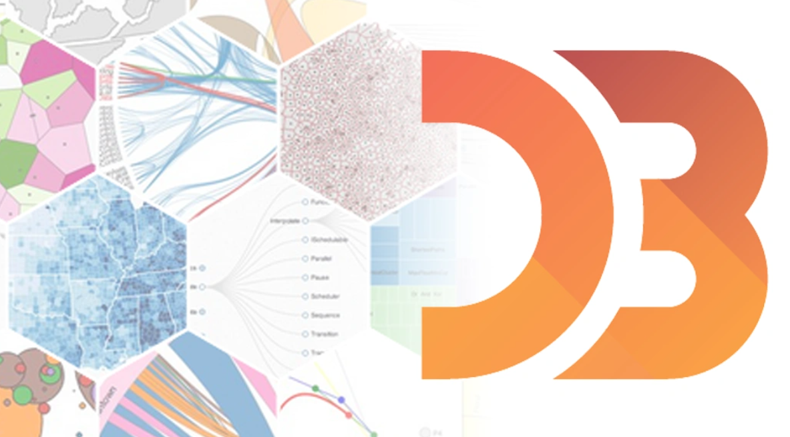

Lessons Learned
Amee Kivette
Creating prototypes of multiple potential solutions:
Allows deeper exploration before committing to a solution
Ensures the solution is a good fit for the project requirements
Creates a strong foundation for future work

Slide 57
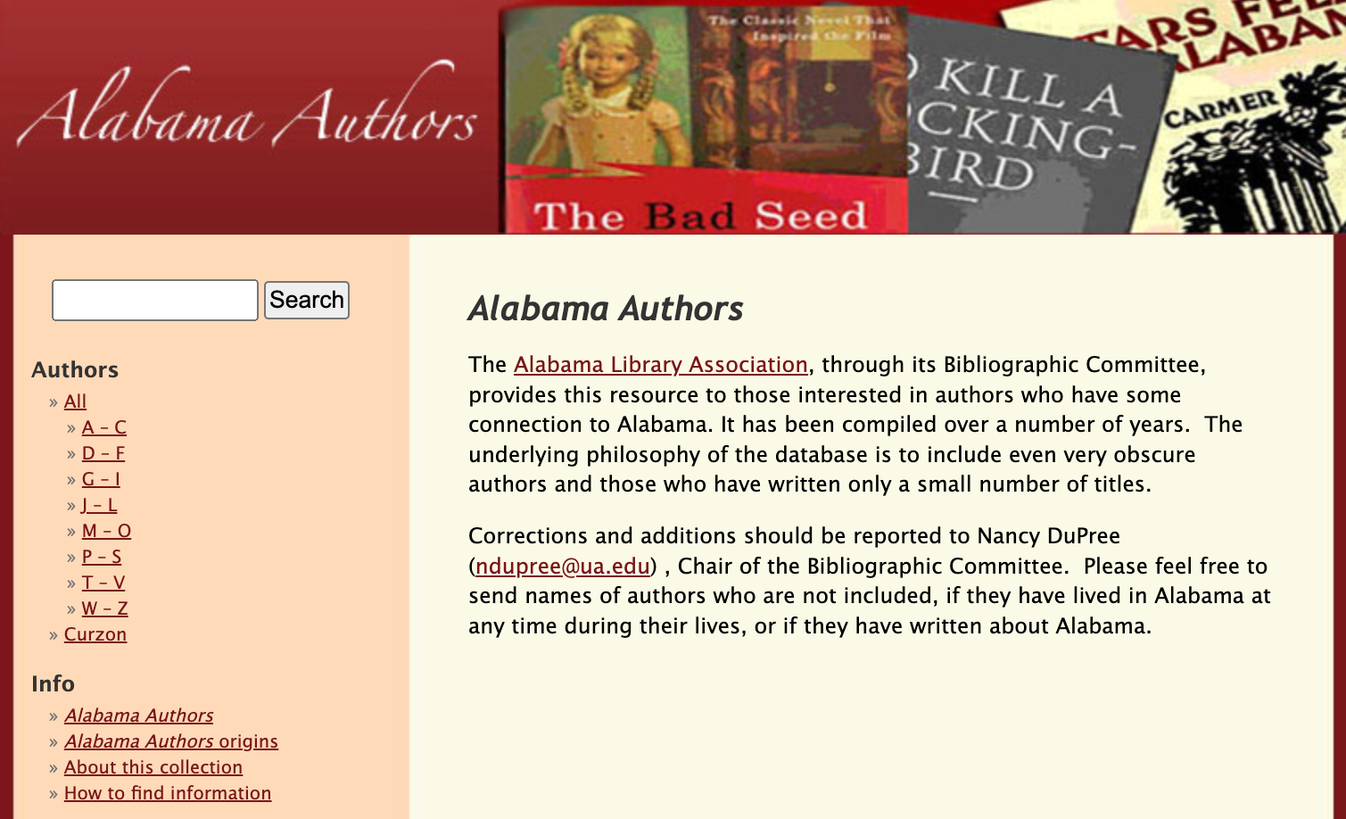

Lessons Learned
Amee Kivette
Performing usability analysis on multiple similar websites:
Guides the team’s understanding of the user experience
Reinforces ideas surrounding resource accessibility and consistency of users’ experiences
University of Alabama, Alabama Authors website
The Goodly Land website

Slide 58

Lessons Learned
Amee Kivette
Changing the scope of the project :
As limitations within existing architectures arise, it may be necessary to change the scope of the project
Having the agility to adapt to these changes is crucial in order to deliver the desired functionality within the given time constraints
Neatline exhibit for author data using timeline widget
Neatline exhibit for publication data using waypoints widget

Slide 59
Lessons Learned
Amee Kivette
Accessibility is key:
Usability testing is not optional
Used Tableau 10 color palette for data visualization
Testing revealed that the visualization colors were not completely accessible
Resulted in a simplified and color-blind-friendly data visualization
D3.js chronology before color adjustment
D3.js chronology after color adjustment

Slide 60
Lessons Learned
Amee Kivette
Accessibility is key
Color contrast testing resulted in a simplified and color-blind-friendly data visualization
Adding in support for tabbing opened up room for a wider audience and reach
Responsiveness provided flexibility that will keep users coming back
D3.js chronology before color adjustment
D3.js chronology after color adjustment

Slide 61

Lessons Learned
Amee Kivette
Documentation is crucial
Lots of moving parts to the project
Omeka Classic
Neatline Plugin
GitHub Pages
D3.js Chronology
D3.js Sunburst
Important to keep current and future researchers up to date
Neatline visualization on published on Alabama Authors website with usability instructions

Slide 62

Current Plans
Keanna Tennyson
Continue adding documentation
Alabama Authors website
Instructions for Neatline, chronology, and sunburst visualizations
User Guide Documents
Developer Guide Documents
Neatline calendar wheel
D3.js chronology sorted by descending birth year

Slide 63


Future Work
Keanna Tennyson
Add additional data visualizations
Graph visualization plugins on Omeka Classic
Conduct usability reviews to validate accessibility requirements
Web Content Accessibility Guidelines (WCAG)
Address minor bugs with tab functionality on D3.js visualizations
Archiviz plugin on Omeka Classic

Slide 64
Demo
Alabama Authors Website

Slide 65

Thank you!
Questions?

